Slide 1

Ear and Brain
Auditory Neuroscience 2
Prof. Jan Schnupp
wschnupp@cityu.edu.hk
http://auditoryneuroscience.com

Slide 2
1: A Refresher Of Basic Neuroscience Ideas

Slide 3
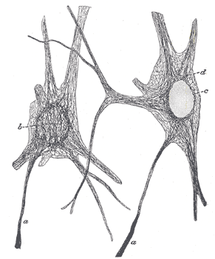
Recipe for Neurons
Ingredients:
Water
Salt
Fat
Protein

Slide 4
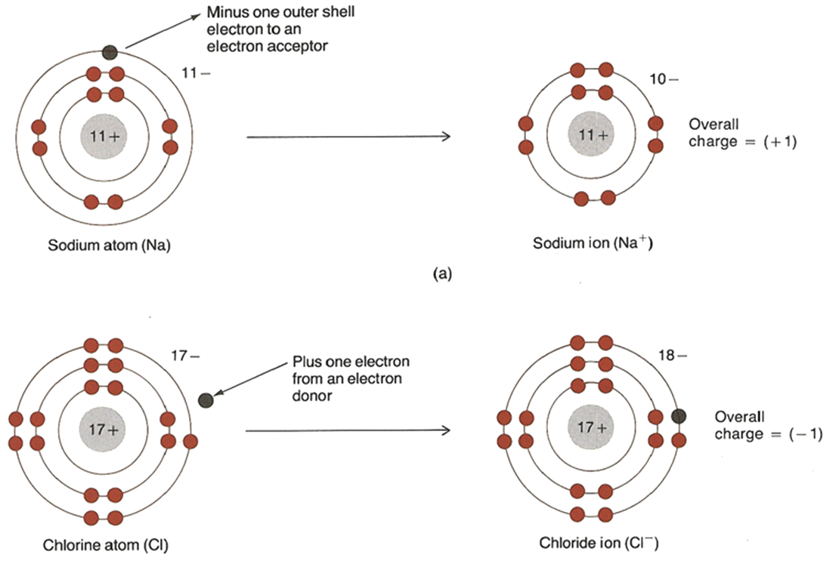
Salts form Ions
Na
Na+
Cl
Cl-

Slide 5
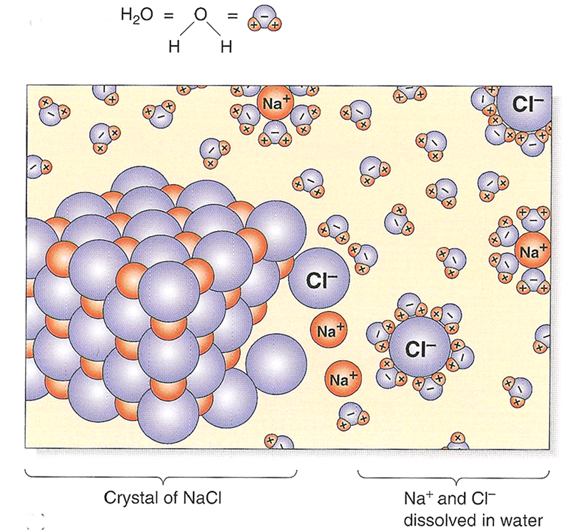
Salt in Solution
When dissolved in water, salts dissociate into electrically charged ions which can move freely in the solution.

Slide 6
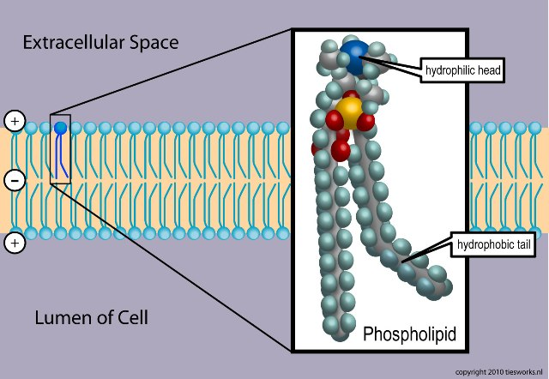
Phospholipid Bilayers
Cell membranes are water-impermeable sheets of phospholipids
Notes:
http://upload.wikimedia.org/wikipedia/commons/3/39/Phospholipid_TvanBrussel.jpg

Slide 7
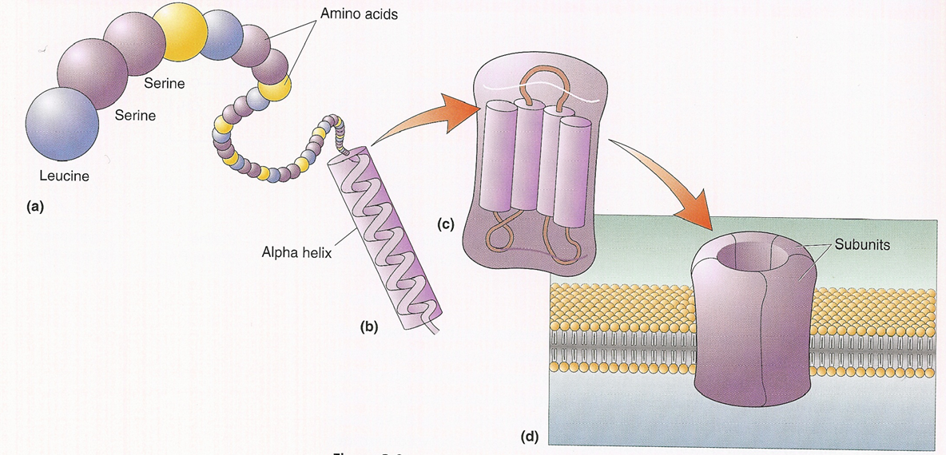
Folding of Protein Chains
Proteins “fold” to form useful building blocks,
like trans-membrane channels, enzymes, or structural proteins

Slide 8
Ionic Concentrations
Ion
Conc. In (mM)
Conc. Out (mM)
Na
+
18
150
Cl
-
7
120
Ca
++
0.00001
1.2
K+
135
5
organic anions
74
13
Approximate intracellular and extracellular concentrations of a number of important ion species for a “typical mammalian neuron”.
(You don’t have to remember them)

Slide 9
Remember This!
Na⁺ and Cl⁻ concentrations are higher outside the neuron than inside.
K⁺ and A⁻ concentration are higher inside than outside.
Neurons are in electrochemical equilibrium. That means the diffusion of an ion out of the cell down a concentration gradient is balanced by an attraction of the ion back into the cell by a voltage gradient.

Slide 10
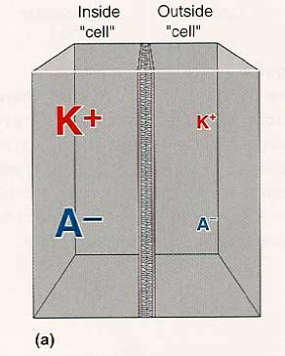
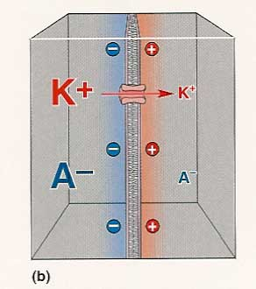
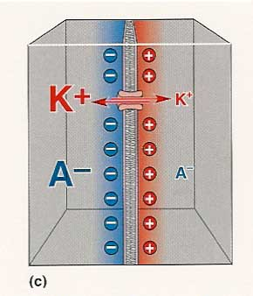
Electrochemical Equilibrium
Ions diffuse through selective channels in a membrane.
Their partners of opposite charge are left behind.
An electrical gradient is set up across the membrane.
Further diffusion is opposed by the electrical gradient.

Slide 11
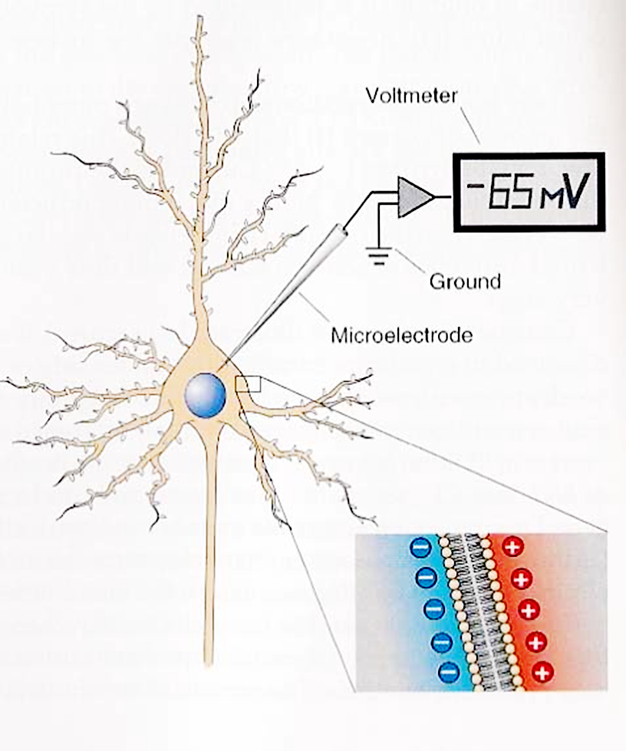
Resting Membrane Potentials
All cells (not just neurons) display an electrical potential across their cell membranes.
At rest, neurons display a ‘resting membrane potential’ of around -70 mV.
Given that the membrane is only 10 nanometers (billionths of a meter) thick, the electric field strength in the membrane is ca 7 million volts / meter !

Slide 12
From Resting Potentials to Electrical Signals
In addition to the resting (K+ leakage) channels, neurons can have a large variety of gated ion channels which will open transiently in the presence of certain stimuli or chemical signals. These gated channels may be permeable to Na+, Cl- or Ca++.
When these gated channels open, the voltage across the membrane will change to reflect the new permeabilities as predicted by the Goldman equation.
The presence of physical or chemical signals which are capable of opening the gated channels is thus “encoded” as a change in membrane potential.

Slide 13
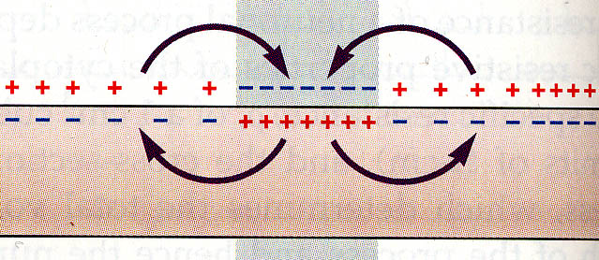
Passive Propagation of Electrical Signals
Ions flow easily along, but not across membrane. (Membrane resistance is much higher, than that of intracellular and extracellular fluid).
To change the potential on a distant patch of membrane, enough current has to flow to discharge the membrane capacitance at that point.

Slide 14
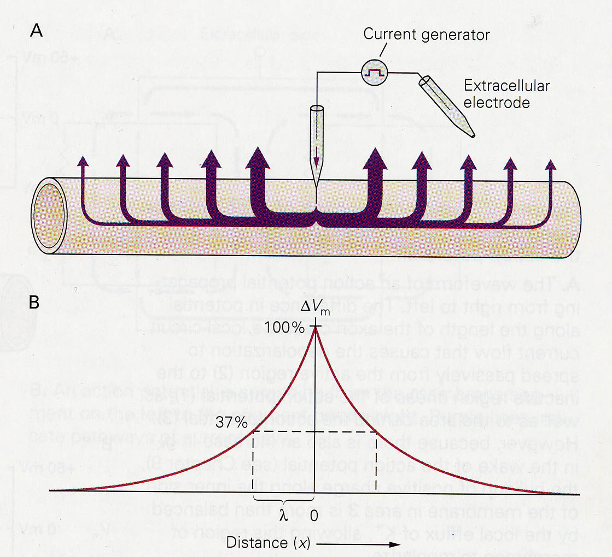
Limitations of Passive, Graded Signals
Some of the current does leak through the membrane.
Consequently passively conducted signals decay after just a few mm (small space constant).

Slide 15
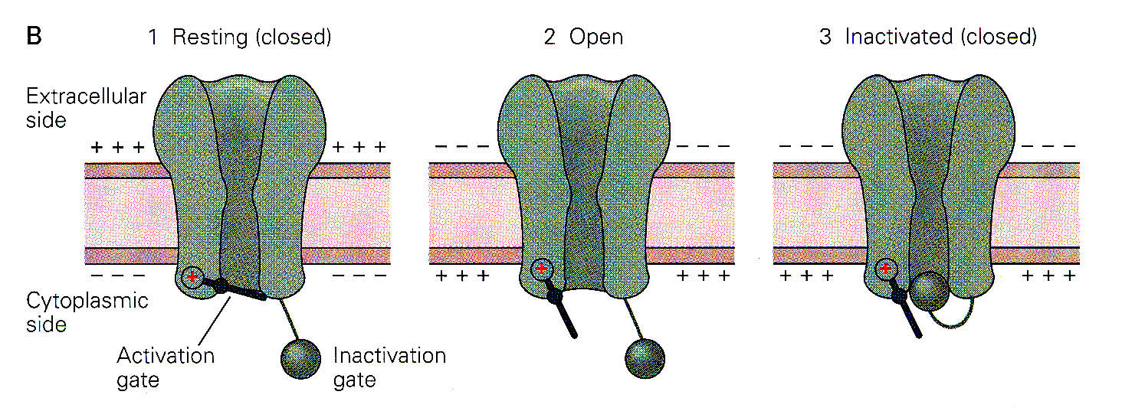
The Voltage Gated Na+ Channel
Normally closed when the membrane is at rest.
Opens briefly (ca 0.5 ms) when the membrane depolarises to a certain threshold.
Once open, rapidly closes again and remains inactivated (“refractory”) for another 0.5 ms or so.

Slide 16
Action Potentials as Positive Feedback Processes
Depolarisation to threshold opens a few Na⁺ channels, which allows further Na⁺ influx, causing further depolarisation, which spreads passively down the axon allowing further Na⁺ channels to open.
This positive feedback process continues until all voltage gated Na⁺ channels in the local patch of membrane have been through the open state and are inactivated (refractory).

Slide 17
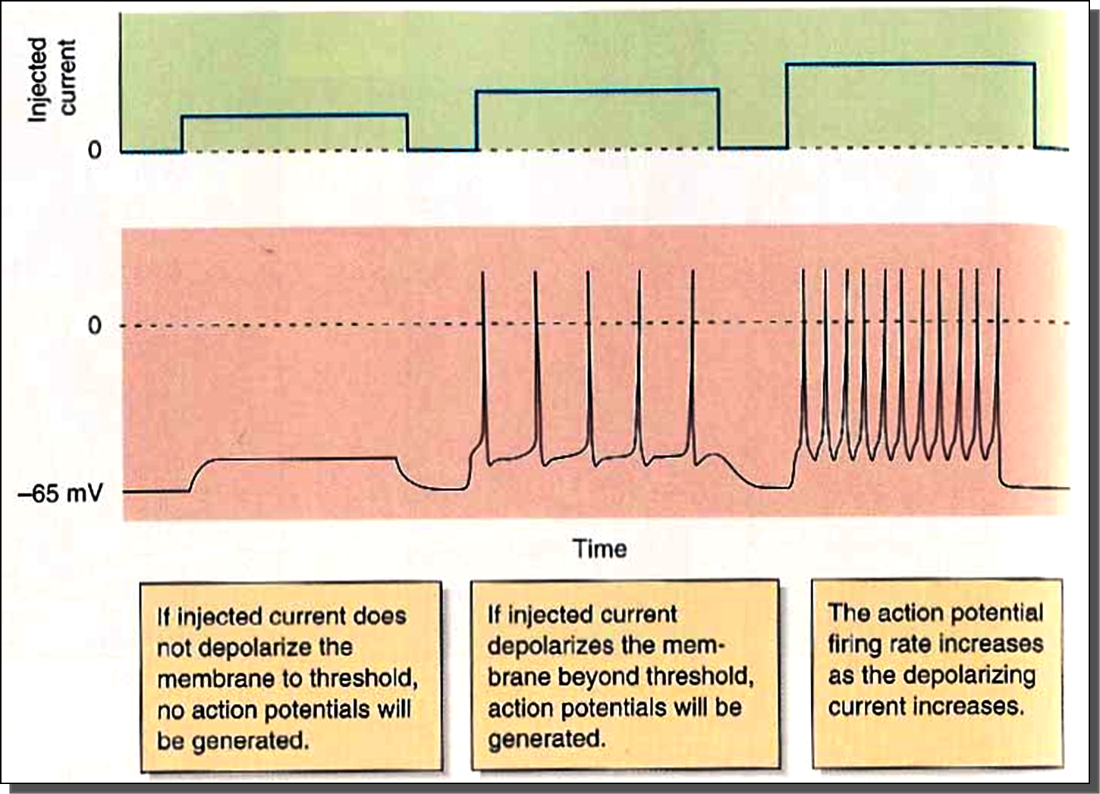
Another Look at AP Initiation:
The Neuronal Threshold

Slide 18
Neurons “encode” injected currents as firing rates
Small, sub-threshold currents injected into a nerve cell don’t do anything, they just leak out again.
Larger currents will trigger action potentials. The stronger the currents, the faster the action potential rate.
=> “Rate Coding”
Reflect on why this is so. If you don’t understand this important principle, ask during the break.

Slide 19
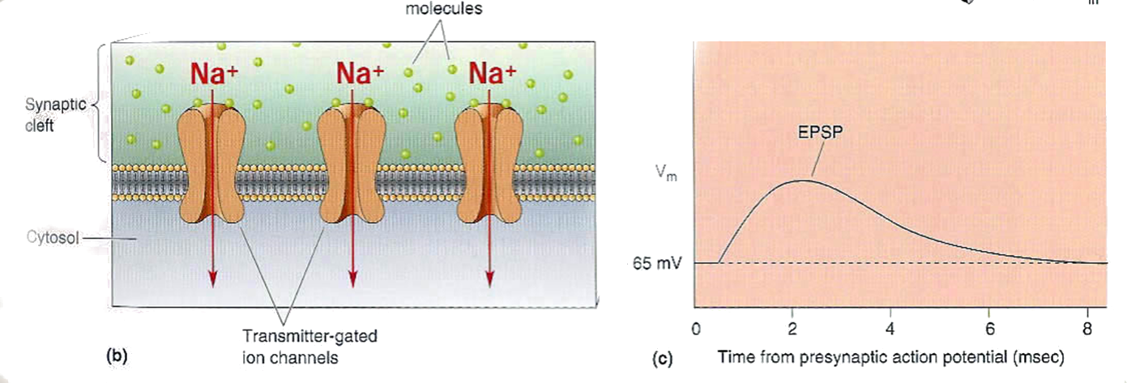
Excitation
Transmitter molecules
Synaptic
cleft
Cytosol
Transmitter gated ion channels
Excitation is achieved when neurotransmitter opens channels permeable to Na+ or Ca++, leading to a current influx and a depolarising excitatory post synaptic potential (EPSP).
Typical examples: AMPA or NMDA receptors at a glutamatergic synapse.

Slide 20
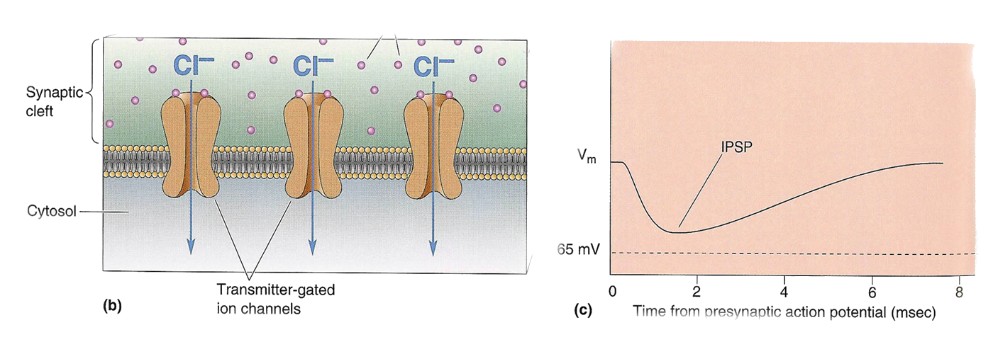
Inhibition
-65mv
One way to achieve inhibition is to open channels which are selectively permeable to Cl-. Note: the Cl- equilibrium potential is close to the normal resting potential (about –65 mV). Hence the inhibitory post synaptic potential (IPSP) may not be very visible unless the cell is already slightly depolarised (“silent inhibition”).
Typical example: GABAergic synapse.

Slide 21
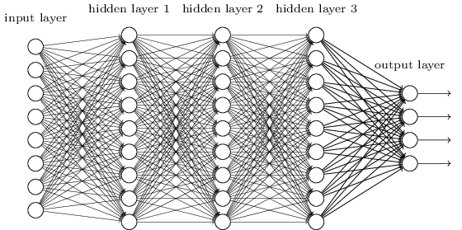
Neural Networks as Computing Devices
Neurons often receive thousands of synaptic inputs and they send out thousands of synaptic outputs (through many axon branches). Consequently, neurons form densely connected networks.
Each neuron constantly sums (“integrates”) the excitation and inhibition it gets. If the sum is above action potential threshold, it fires. If not, it does not.
The synapses between neurons can be “plastic”, meaning that they can get stronger or weaker. This allows the connection patterns in neural network to change in a way that learns new “associations” between the pieces of information represented by the activity of individual neurons.
Notes:
Image source Gray’s anatomy Fig 677

Slide 22
Summary
The voltage across the neural membrane changes when ion channels in the membrane open or close, allowing ions to flow in or out of the cell.
The change in membrane voltage can encode information.
To send the information through “axons” over long distances, neurons fire action potentials (aka nerve impulses). The rate (and timing?!) of those impulses encode information. The maximum rate is less than 1000 Hz.
Networks of neurons process information through patterns of inhibitory and excitatory synaptic connections.

Slide 23
2: Anatomy of the Ear & Cochlear Mechanics

Slide 24
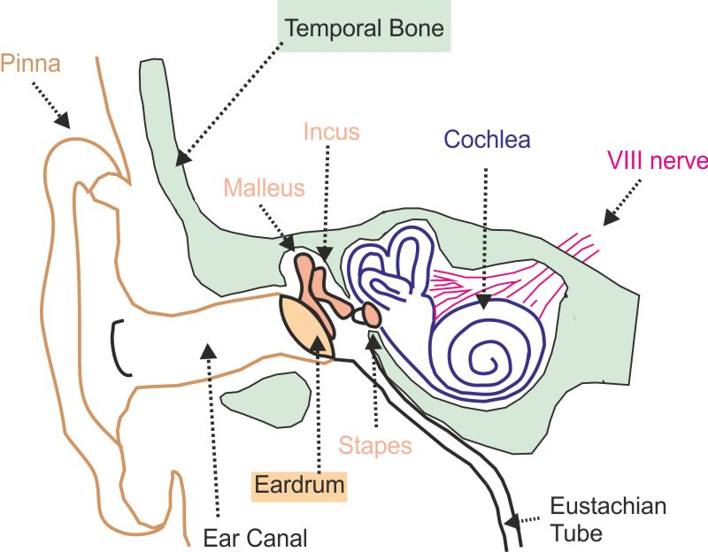
Ear Anatomy

Slide 25
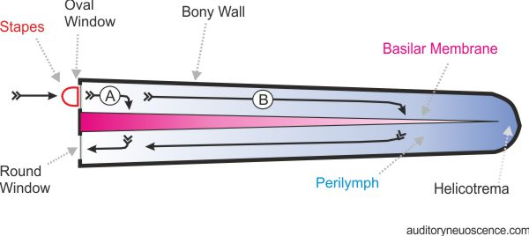
The Cochlea Unravelled

Slide 26
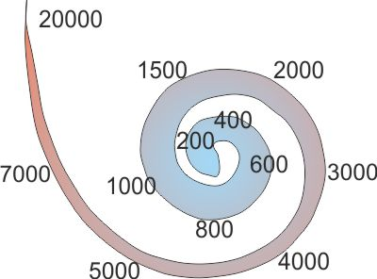
Tonotopy

Slide 27
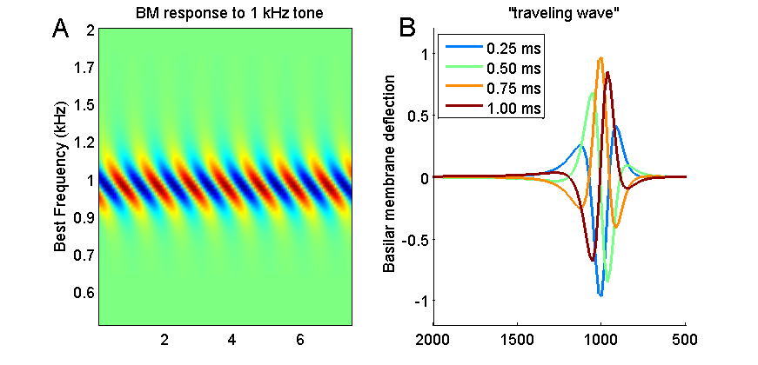
Travelling Wave
http://auditoryneuroscience.com/travellingWave
http://auditoryneuroscience.com/ear/bm_motion_2
http://auditoryneuroscience.com/ear/bm_motion_3

Slide 28
3: “Transduction”
(Encoding of physical signals into neural signals)

Slide 29
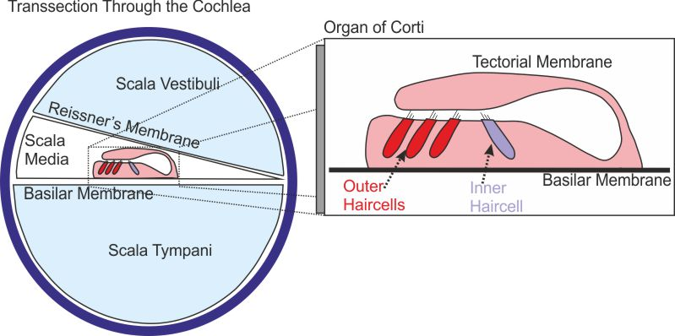
The Organ of Corti

Slide 30
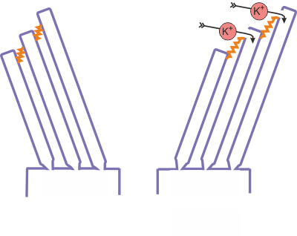
Transduction
Schematic of the hair cell transduction mechanism.

Slide 31
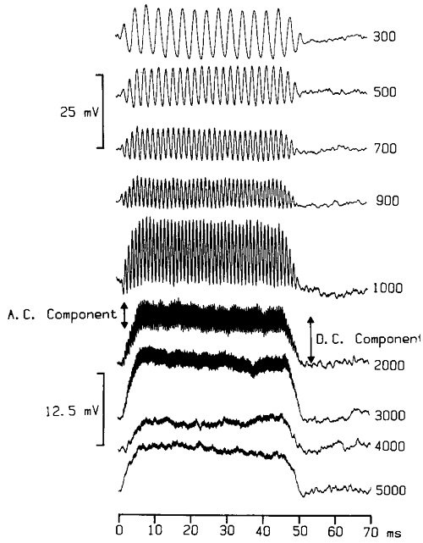
Receptor Potentials
Palmer and Russell (1986), Hear Res 24:1-15

Slide 32
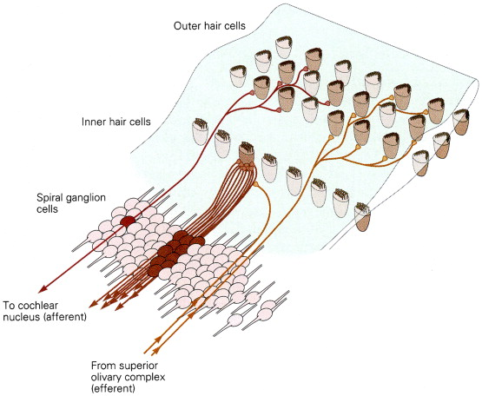
Hair cell connections to VIII nerve
Figure source: Kandel ER. Principles of Neural Science, Fourth Edition. New York: McGraw Hill; 2000:602

Slide 33
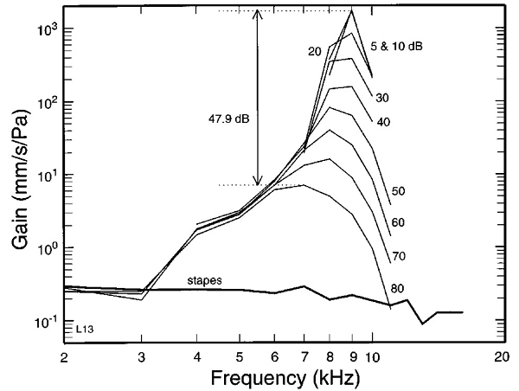
Gain Provided by Outer Haircells
Ruggero et al. (1997), J Acoust Soc Am 101:215
See also http://auditoryneuroscience.com/ear/dancing_hair_cell

Slide 34
3: The Cochlea as a Filter Bank

Slide 35
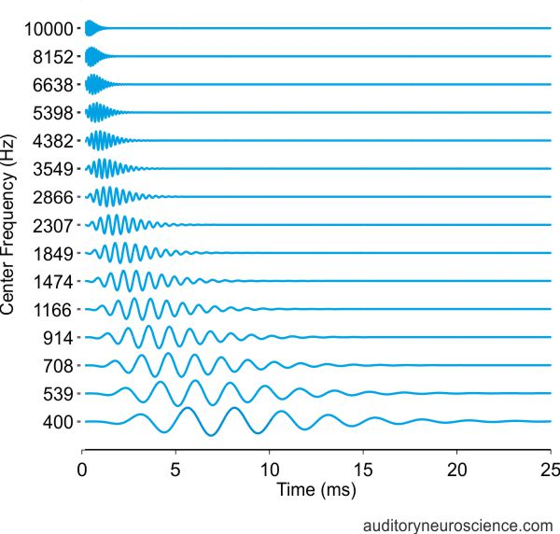
“Gammatone Filter Bank”

Slide 36
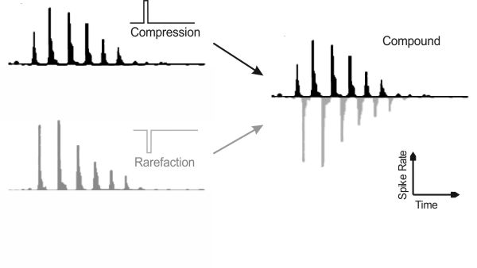
Auditory Nerve Fibers behave like Rectified Gammatone Filters
Auditory Neuroscience Fig 2.12
Based on data collected by Goblick and Pfeiffer (JASA 1969)

Slide 37
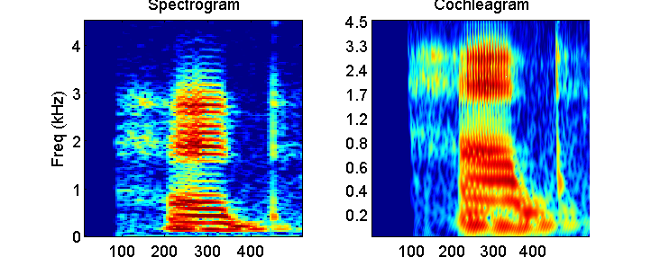
Spectrogram and Cochleagram
Spectrogram of, and basilar membrane response to, the spoken word “head”

Slide 38
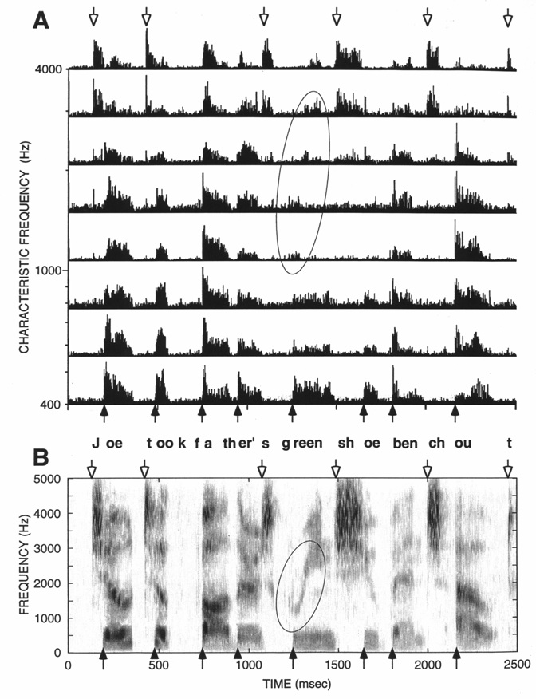
Spectrogram and
Neurogram
From Delgutte (1997),
Handbook of Phonetic Sciences
(Laver, ed), pp 507-538.
Oxford: Blackwell

Slide 39
Phase Locking
http://auditoryneuroscience.com/ear/phase_locking

Slide 40
Squirrel Monkey Phase Locking Data
AN Figure 2.15
Period histograms of responses to pure tones recorded from an auditory nerve fiber in a squirrel monkey. The traces show the proportion of action potentials fired at a particular phase of a pure tone stimulus. The stimulus frequency is indicated in the legend. Based on data collected by Rose et al. (1967).

Slide 41
4: Central Pathways

Slide 42
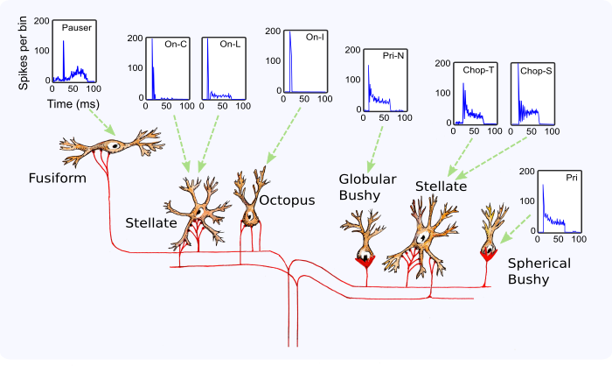
AN Figure 2.16
Cell types of the cochlear nucleus. Pri, primarylike; Pri-N, primarylike with notch; Chop-S, chopper sustained; Chop-T, chopper transient; OnC, onset chopper; OnL, onset locker; OnI, onset inhibited.

Slide 43
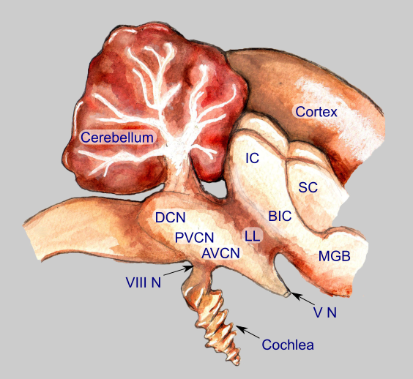
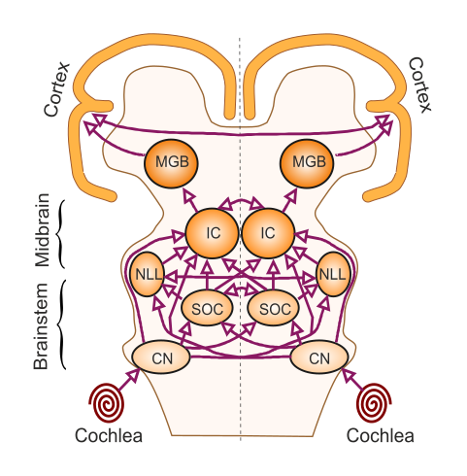
The Auditory Pathway
VIII N: 8th cranial (vestibulo-cochlear) nerve
AVCN, PVCN, DCN: antero-, posteroventral&
dorsal cochlear nuclei;
LL: lateral lemniscus;
IC, inferior colliculus;
BIC: brachium of the inferior colliculus
MGB, medial geniculate body.
CN, cochlear nuclei;
SOC, superior olivary complex;
NLL, nuclei of the lateral lemniscus;
IC, inferior colliculus;
MGB, medial geniculate body.

Slide 44
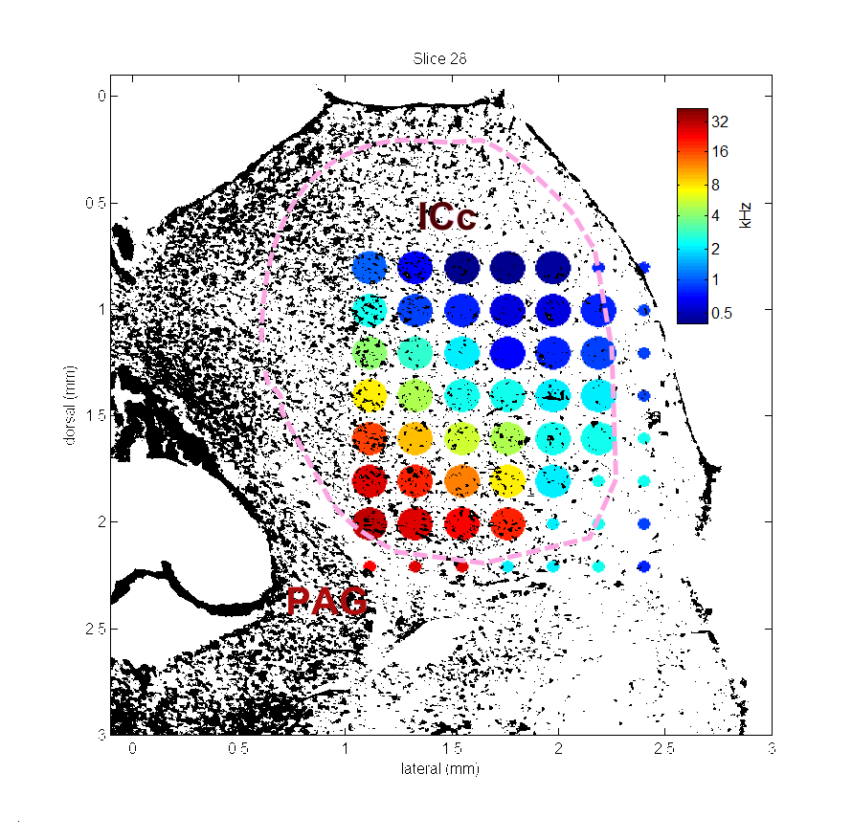
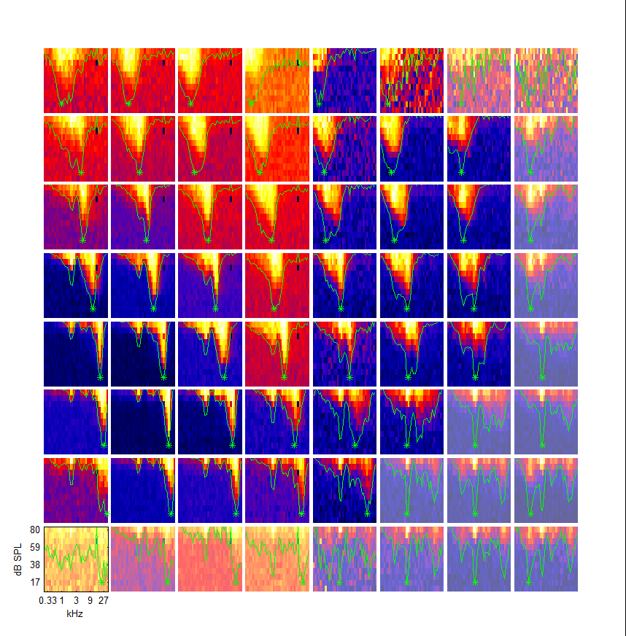
Tonotopy in Inferior Colliculus

Slide 45
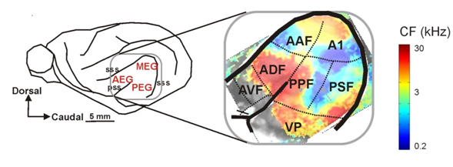
Tonotopy in Cortex
Adapted from: Nelken I, Bizley J, Nodal FR, Ahmed B, Schnupp JWH and King AJ (2004) Large-Scale Organization of Ferret Auditory Cortex Revealed Using Continuous Acquisition of Intrinsic Optical Signals J. Neurophysiol 92(4):2574-88

Slide 46
Auditory Cortex

