Slide 1

Hearing Loss,
Hearing Aids and Cochlear Implants
Auditory Neuroscience
Prof. Jan Schnupp
wschnupp@cityu.edu.hk
http://auditoryneuroscience.com

Slide 2
Hearing Loss
Types of Hearing Loss
Quantifying Hearing Loss
Notes:
2

Slide 3
Common Types of Hearing Loss
Conductive:
Damage to tympanic membrane
Occlusion of the ear canal
Otitis Media (fluid in middle ear)
Otosclerosis (calcification of ossicles)
Sensory-Neural:
Damage to hair cells due to innate vulnerability, noise, old age, ototoxic drugs.
Damage to auditory nerve, often due to acoustic neuroma.
Notes:
3

Slide 4
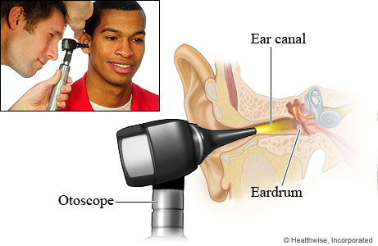
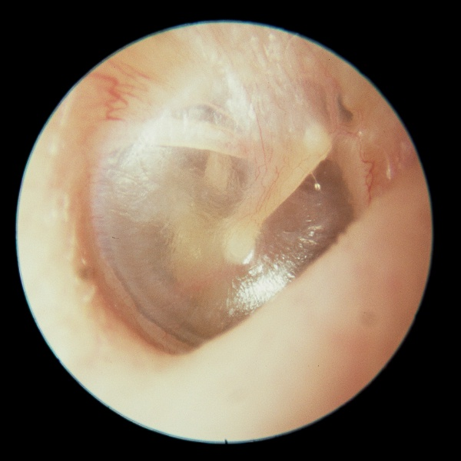
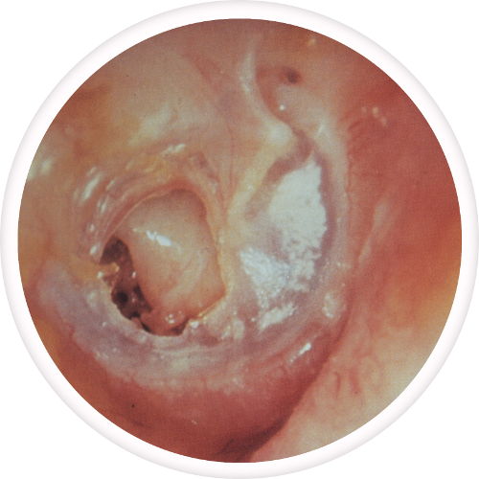
Otoscopy

Slide 5
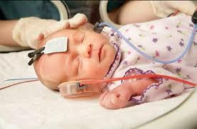
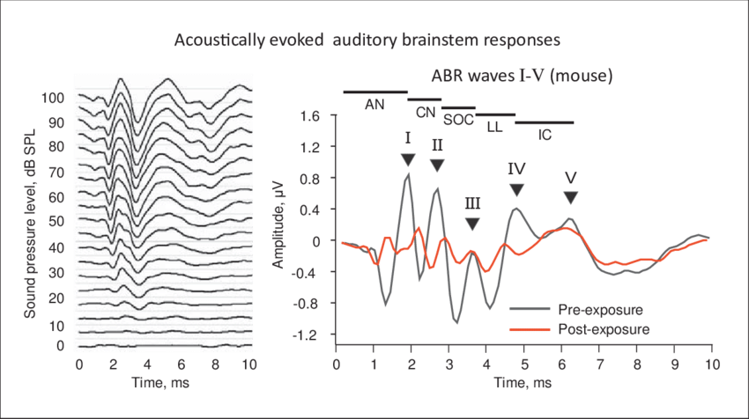
Auditory Brainstem
Response

Slide 6
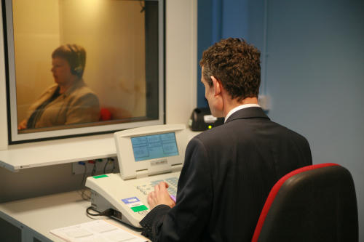
Pure Tone
Audiometry
Put headphones on subject. Place in quiet environment. Vary intensity of pure tones at
125, 250, 500, 1000, 2000, 4000, 8000 Hz
to find quietest sound level (in dB) that the subject can no longer hear.
http://auditoryneuroscience.com/pure-tone-audiogram

Slide 7
The Decibel Scale
Large range of possible sound pressures usually expressed in “orders of magnitude”.
1,000,000 fold increase in pressure =
6 orders of magnitude = 6 Bel = 60 dB.
dB amplitude:
y dB = 10 log₁₀(x/x_{ref})
0 dB implies x=x_{ref}
Notes:
7

Slide 8
dB SPL (Sound Pressure Level)
“Levels” (or equivalently, “Intensities”) quantify energy delivered / unit area and time. Remember that kinetic energy is proportional to particle velocity squared, and velocity is proportional to pressure.
Hence:
y dB SPL = 10 log₁₀((x/x_{ref})²) = 20 log₁₀(x/x_{ref})
where x is sound pressure and x_{ref} is a reference pressure of 20 μPa
Notes:
8

Slide 9
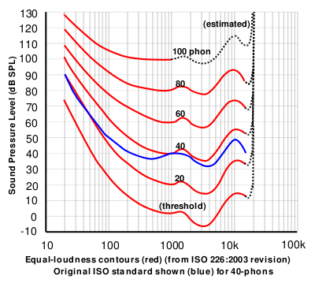
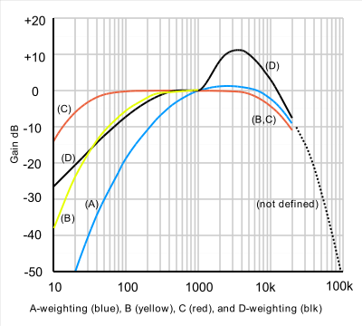
dB SPL and dB A
Iso-loudness contours
A-weighting filter (blue)
Image source: wikipedia
Notes:
9
http://upload.wikimedia.org/wikipedia/commons/thumb/3/39/Acoustic_weighting_curves_%281%29.svg/400px-Acoustic_weighting_curves_%281%29.svg.png
http://upload.wikimedia.org/wikipedia/commons/thumb/4/47/Lindos1.svg/400px-Lindos1.svg.png

Slide 10
dB HL (Hearing Level)
Threshold level of auditory sensation measured in a subject or patient, above “expected threshold” for a young, healthy adult.
-10 - 25 dB HL: normal hearing
25 - 40 dB HL: mild hearing loss
40 - 55 dB HL: moderate hearing loss
55 - 70 dB HL: moderately severe hearing loss
70 – 90 dB HL: severe hearing loss
> 90 dB HL: profound hearing loss
http://auditoryneuroscience.com/acoustics/clinical_audiograms
Notes:
10

Slide 11
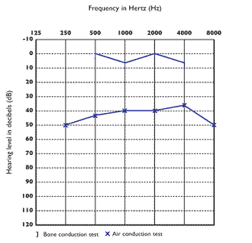
Typical audiogram of conductive hearing loss
Notes:
11

Slide 12
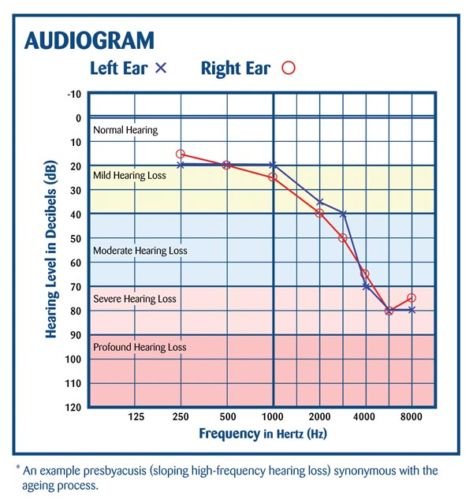
Typical Age-related Hearing Loss Audiogram
Notes:
12

Slide 13
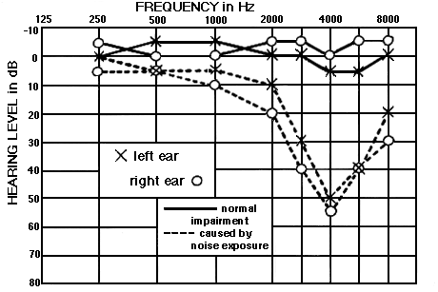
Typical Noise Damage Audiogram
Notes:
13

Slide 14
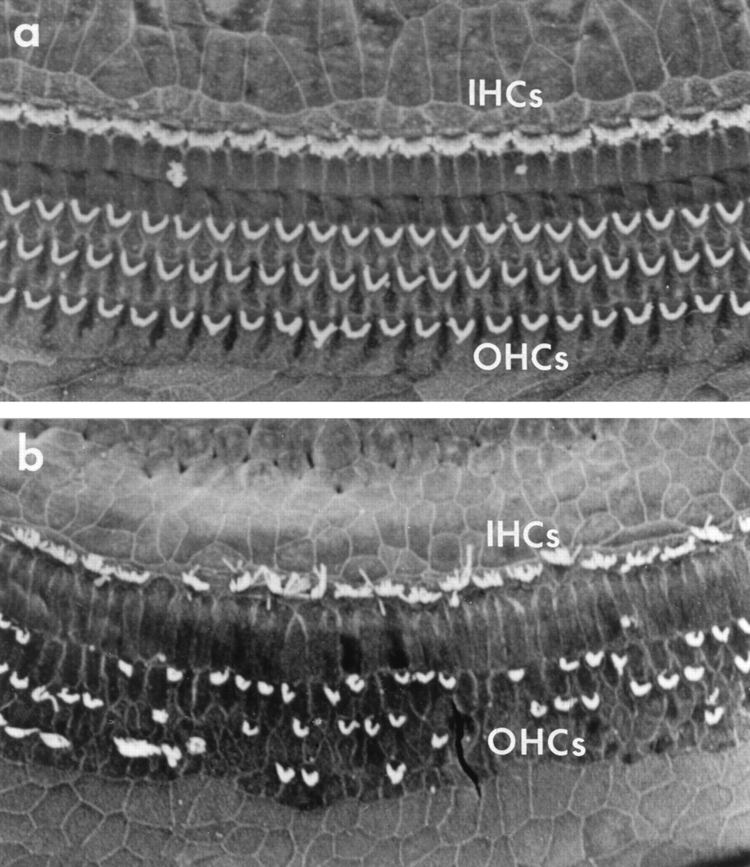
Hair Cells
With and Without Noise Damage
Notes:
14

Slide 15
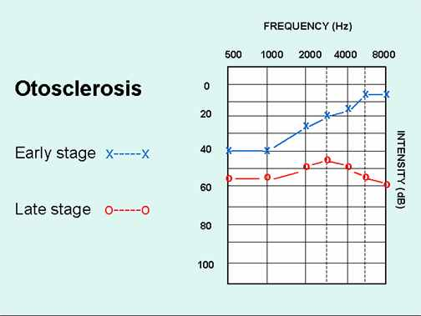
Typical audiogram of early and late stage otosclerosis
Notes:
15

Slide 16
Hearing Aids
Notes:
16

Slide 17
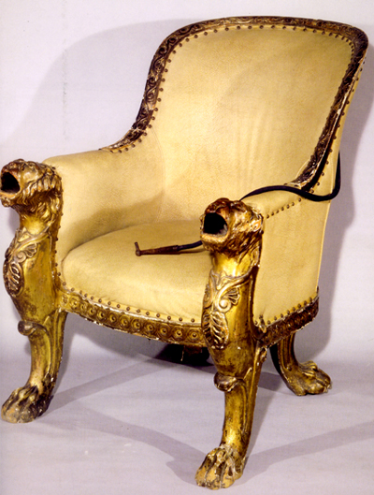
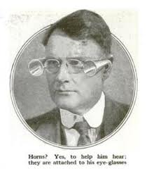
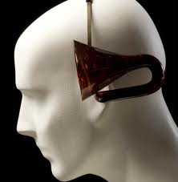
Early Hearing Aids
“Ear Trumpets”
Notes:
17

Slide 18
Limitations of Early Hearing Aids
Not very pretty, bulky, impractical.
Range of sound frequencies that are amplified depends on resonance of device and is usually not well matched to the patient's needs.
Amplification provided by ear trumpet is strictly linear, yet non-linear (“compressive”) amplification would provide better compensation for outer hair cell damage.
Notes:
18

Slide 19
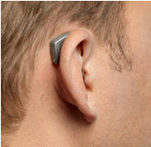
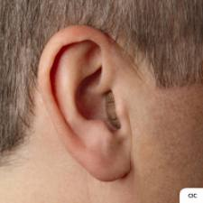
Modern Hearing Aids
Tend to be small to be easily concealed behind the ear or in the ear canal.
Have non-linear amplification.
Amplified frequency range must be matched to the particular hearing loss of the patient.
May use directional microphones and digital signal processing to do clever things such as noise suppression or frequency shifting.
Ca 12% of issued hearing aids are never worn, probably because they don't meet the patient's needs. (Source: http://www.betterhearing.org/pdfs/M8_Hearing_aid_satisfisfaction_2010.pdf)
Notes:
19

Slide 20
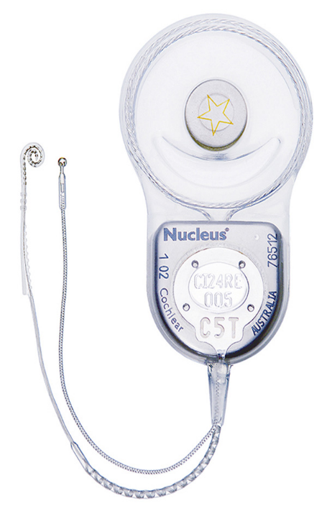
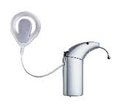
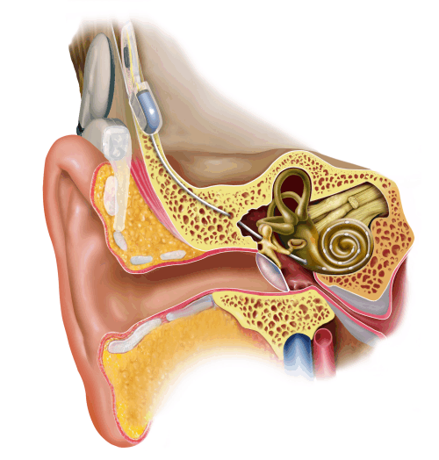
Cochlear Implants
Receiver with stimulating
reference electrode and
Emitter
Speech Processor
Notes:
20
http://www.google.co.uk/url?sa=i&rct=j&q=&esrc=s&source=images&cd=&cad=rja&docid=axByeOIGW0GhLM&tbnid=1Yyuw4kHiQ16RM:&ved=0CAQQjB0&url=http%3A%2F%2Fwww.felixmay.com%2FESB%2Fbrainimplants.htm&ei=NpgjUZ2SBa-U0QWSs4C4BA&bvm=bv.42553238,d.d2k&psig=AFQjCNEER2EQYwko97k1AabpNT_upWWrZw&ust=1361373577987926

Slide 21
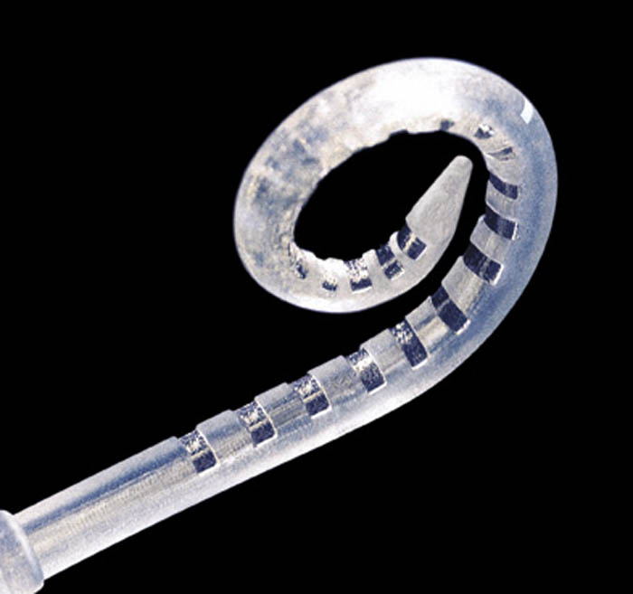
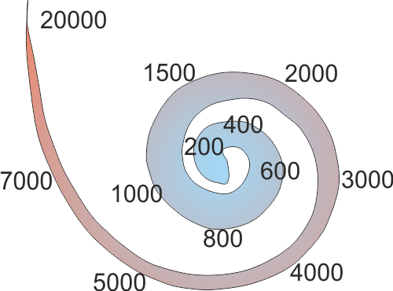
Cochlear Implants:
Stimulating Electrode
Notes:
21
http://www.google.co.uk/url?sa=i&rct=j&q=&esrc=s&source=images&cd=&cad=rja&docid=axByeOIGW0GhLM&tbnid=1Yyuw4kHiQ16RM:&ved=0CAQQjB0&url=http%3A%2F%2Fwww.felixmay.com%2FESB%2Fbrainimplants.htm&ei=NpgjUZ2SBa-U0QWSs4C4BA&bvm=bv.42553238,d.d2k&psig=AFQjCNEER2EQYwko97k1AabpNT_upWWrZw&ust=1361373577987926

Slide 22
Limitations of Cochlear Implants
The electrode array does not reach the most apical turn of the cochlea.
Modern implants have ca 20-odd electrode channels, but because the electrodes are partly “short circuited” by the highly conductive perilympthatic fluid of the scala tympani, the number of “effective” separate frequency channels is probably no more than 8 or 9.
A variety of techniques are used to try to minimize cross-talk between channels (with only moderate success).
Notes:
22

Slide 23
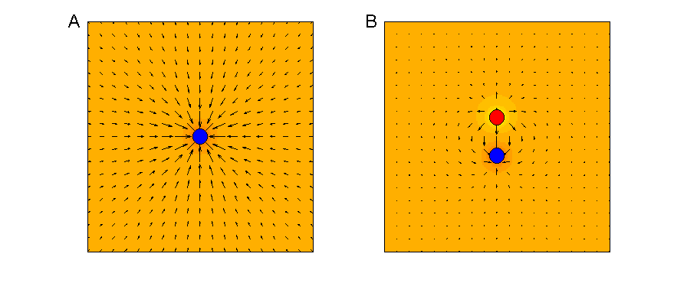
Monopolar (A) and bipolar (B) electrodes.
A) Electric fields around a monopolar electrode drop off according to the inverse square law.
B) In bipolar electrodes, opposite fields can cancel each other out, restricting the spatial extent of the electric field.
Auditory Neuroscience Figure 8.3
Notes:
23

Slide 24
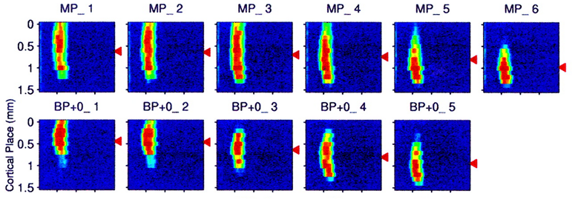
Activation of guinea pig auditory cortex in response to CI stimulation with monopolar (MP) or bipolar (BP) electrode configuration.
AN Fig 8.4 Adapted from figure 4 of Bierer and Middlebrooks (2002) J Neurophysiol 87:478-492
Bipolar stimulation helps keep the area of auditory cortex activated by CI electrodes smaller (but not by much).
Notes:
24

Slide 25
Encoding Sounds for Cochlear Implants:
What does the “speech processor” do?
Notes:
25

Slide 26
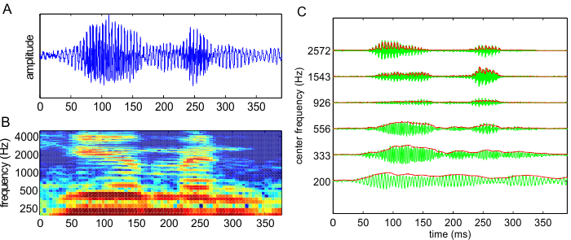
Bandpass & envelope extraction
Figure 8.5
(A) Waveform of the word “human” spoken by a native American speaker. (B) Spectrogram of the same word. (C) Green lines: Output of a set of six bandpass filters in response to the same word. The filter spacing and bandwidth in this example are two-thirds of an octave.
Notes:
26

Slide 27
Continuous Interleaved Sampling (CIS)
Notes:
27

Slide 28
Noise Vocoded Speech as a Simulation of Cochlear Implants
Normal Speech
CI Speech
Bandpass sound signal and extract envelopes for each band.
Take narrowband noises centered on each band and amplitude modulate them according to the envelope.
http://auditoryneuroscience.com/?q=prosthetics/noise_vocoded_speech
Notes:
28

Slide 29
Spatial Hearing Through CIs Is Poor
Many CI patients have only one implant => no binaural cues.
UK children are now routinely fitted bilaterally, but the limited dynamic range of the electrodes limits ILD coding, and a lack of synchronization of implants between the ears limits ITD coding.
Notes:
29

Slide 30
Pitch Perception Through CIs is Poor
Too few effective channels to provide place code for harmonic structure.
CIS stimulation strategies do not convey temporal fine structure cues to the periodicity of the sound.
This limits the ability to appreciate melodies or to use pitch as a scene segregation cue to hear out voices from background noise.
Notes:
30

Slide 31
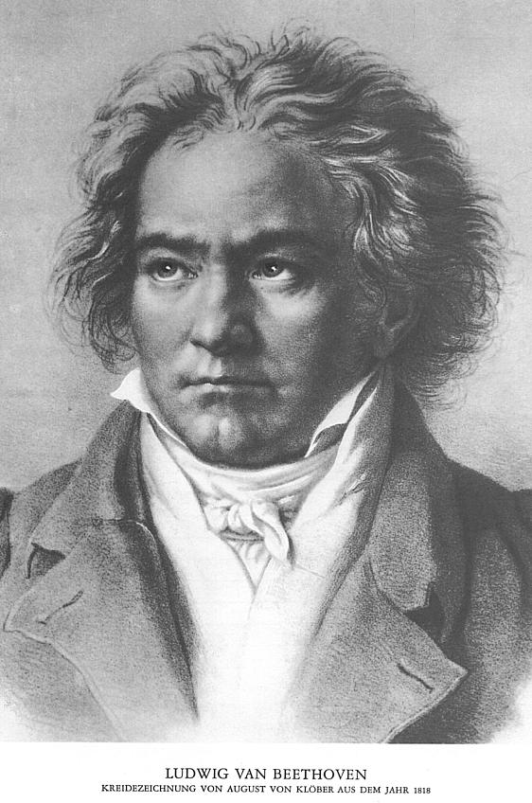
Cochlear Implants
Music in your Ears?
Normal Ludwig
CI Ludwig
http://auditoryneuroscience.com/prosthetics/music
Notes:
31

Slide 32
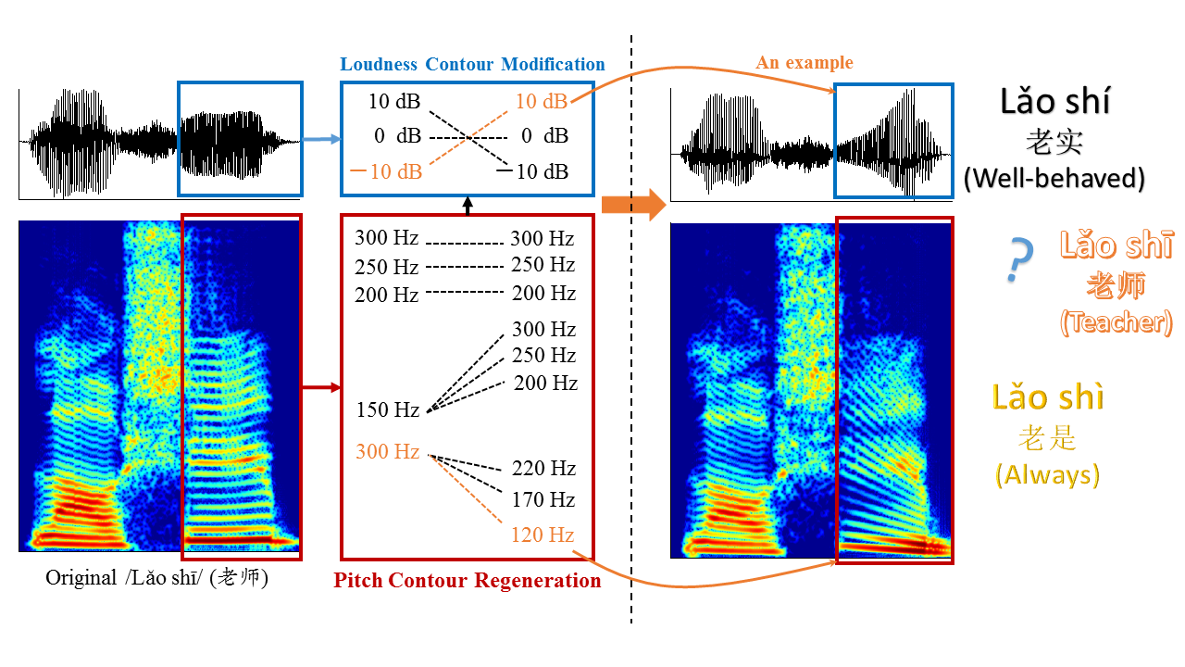
Speakers of tonal languages may miss out on pitch cues to lexical tone with CIs.
Meng et al (2018): Mandarin tones are distinguished by pitch contour, but also by duration and loudness cues. CI users may rely much more on loudness cues, while normally hearing native Chinese speakers go almost entirely by pitch contour.

Slide 33
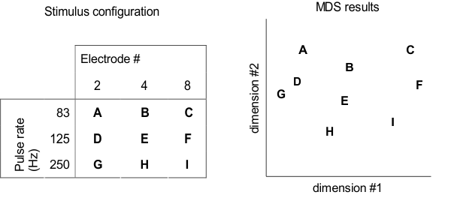
Pitch Judgements Through Cochlear Implants
Figure 8.7
Perceptual multidimensional scaling (MDS) experiment by Tong and colleagues (1983). Cochlear implant users were asked to rank the dissimilarity of nine different stimuli (A–I), which differed in pulse rates and cochlear locations, as shown in the table on the left. MSD analysis results of the perceptual dissimilarity (distance) ratings, shown on the right, indicate that pulse rate and cochlear place change the implantee’s sound percept along two independent dimensions.
Notes:
33

Slide 34
Further Reading
Auditory Neuroscience – Chapter 8
Notes:
34

