Slide 1

An Introduction to Sound
Auditory Neuroscience 1
Prof. Jan Schnupp
wschnupp@cityu.edu.hk
http://auditoryneuroscience.com

Slide 2
1: Sound Sources
Why and how things vibrate

Slide 3
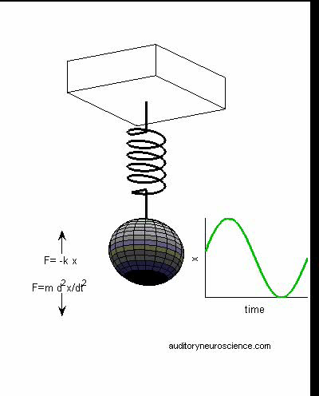
“Simple Harmonic Motion”
Physical objects which have both spring-like stiffness and inert mass (“spring-mass systems”) like to vibrate.
Higher stiffness leads to faster vibration.
Higher mass leads to slower vibration.
http://auditoryneuroscience.com/acoustics/simple_harmonic_motion

Slide 4
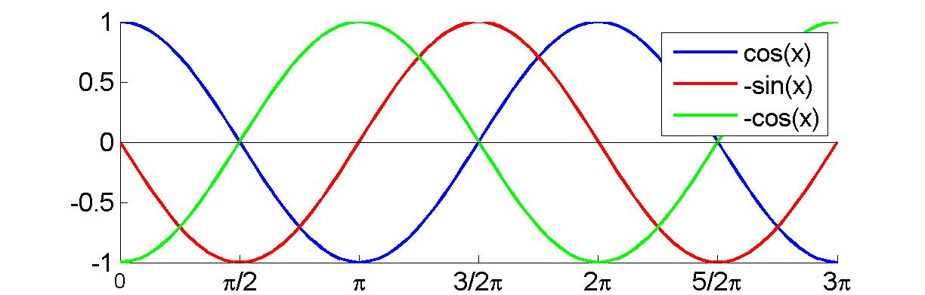
The Cosine and its Derivatives

Slide 5
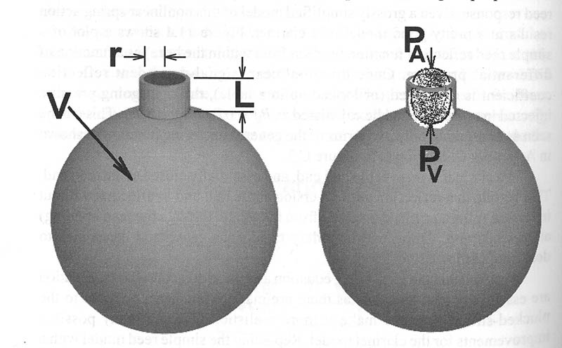
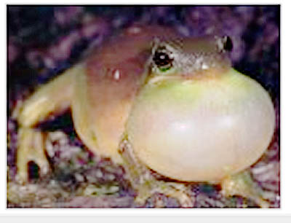
Resonant Cavities
In resonant cavities, “lumps of air” at the entrance/exit of the cavity oscillate under the elastic forces exercised by the air inside the cavity.
The preferred resonance frequency is inversely proportional to the square root of the volume. (Large resonators => deeper sounds).

Slide 6
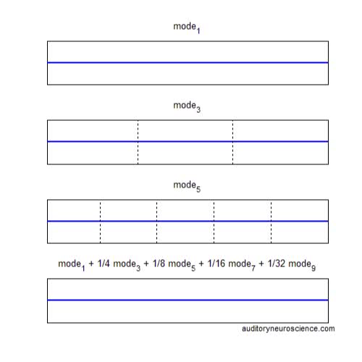
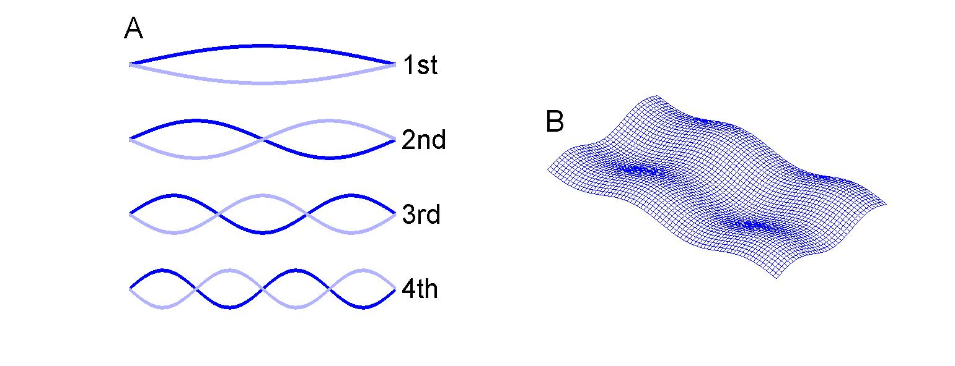
Modes of
Vibration
http://auditoryneuroscience.com/acoustics/modes_of_vibration
http://auditoryneuroscience.com/acoustics/modes-vibration-2-d

Slide 7
Overtones & Harmonics
The note B3 (247 Hz) played by a Piano and a Bell

Slide 8
Damping

Slide 9
2: Describing Vibrations Mathematically

Slide 10
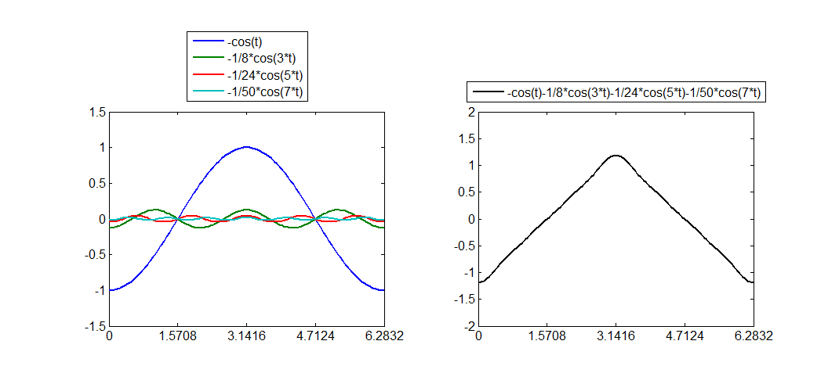
Making a Triangle Wave from
Sine Waves (“Fourier Basis”)

Slide 11
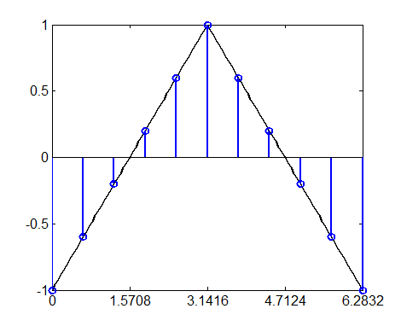
Making a Triangle Wave from Impulses (“Nyquist Basis”)
x(t)=
-δ(0)…
-2/3 δ(1 π/5)…
-1/3 δ(2 π/5)…
+1/3 δ(3 π/5)…
+2/3 δ(4 π/5)…
+3/3 δ(5 π/5)…
+ …

Slide 12
Fourier Synthesis of a Click

Slide 13
The Effect of Windowing on a Spectrum

Slide 14
Time-Frequency Trade-off

Slide 15
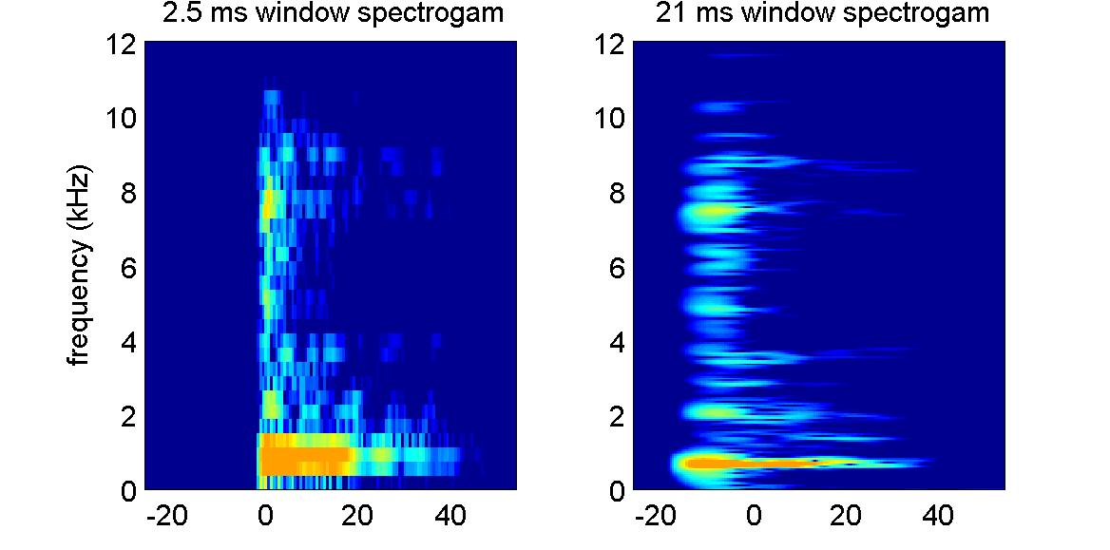
Spectrograms with Short or Long Windows

Slide 16
3: Impulse responses, linear filters and voices

Slide 17
Impulse Responses (Convolution)

Slide 18
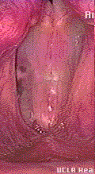
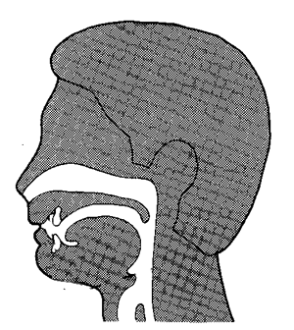
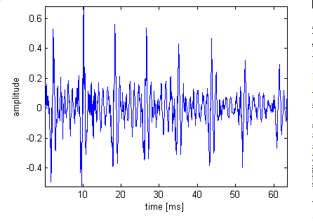

Vowel Sounds
Banal “AAAhh”
Superlative “AAAhh”
When someone vocalizes, the glottal folds (vocal chords) open and shut periodically, producing a glottal pulse train with a frequency of around 100 Hz.
The rate of the glottal pulses determines the harmonic structure, and therefore the melodic pitch, of a vowel.
The glottal pulses excite (and are filtered by) resonant cavities in the throat, mouth and nose.

Slide 19
Click Trains, Harmonics and Voices
http://auditoryneuroscience.com/vocal_folds

Slide 20
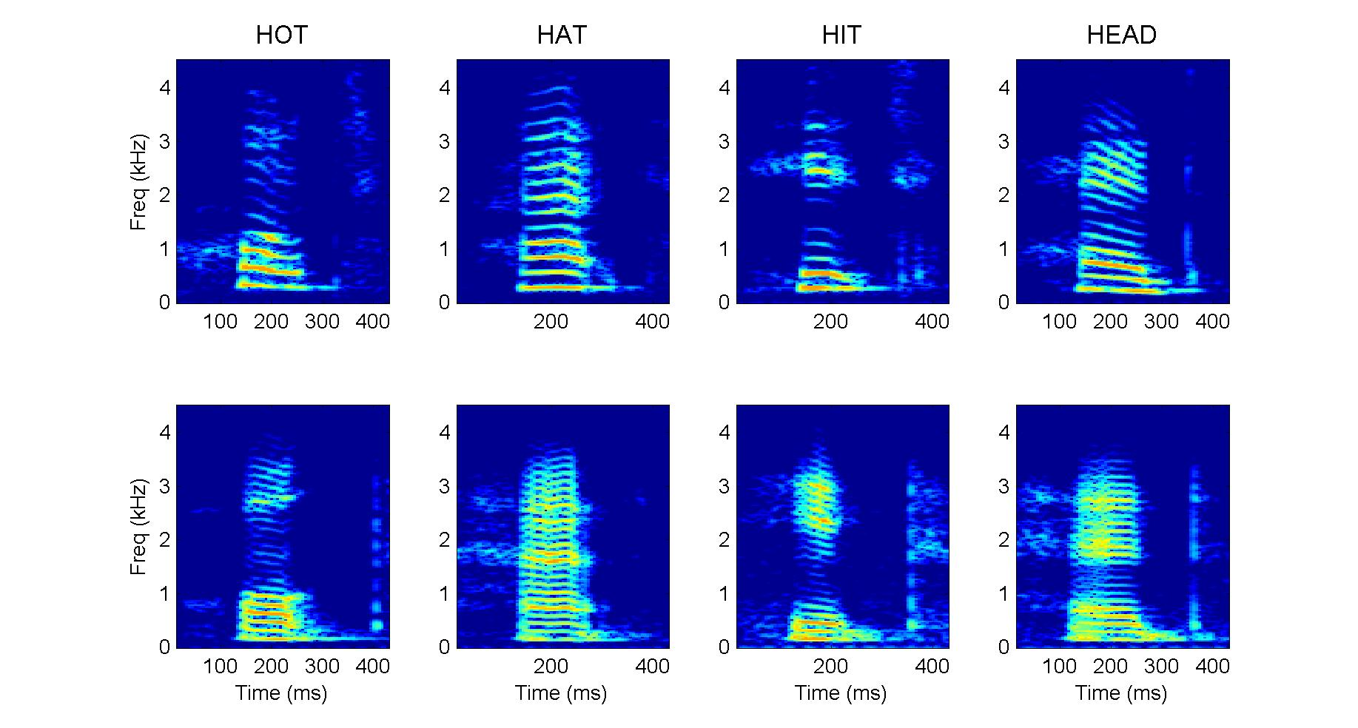
Low and High Pitched Voices

Slide 21
4: Sound Propagation

Slide 22
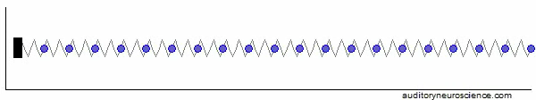
Sound Propagation
http://auditoryneuroscience.com/acoustics/sound_propagation

Slide 23
The Inverse Square Law
Sound waves radiate out from the source in all directions.
They get “stretched” out as the distance from the source increases.
Hence sound intensity is inversely proportional to the square of the distance to the source.
http://auditoryneuroscience.com/acoustics/
inverse_square_law

Slide 24
Velocity and Pressure Waves
Pressure (P) is proportional to force (F) between adjacent sound particles.
Let a sound source emit a sinusoid.
F = m ∙ a = m ∙ dv/dt = b ∙ cos(f ∙ t)
v = ∫ b/m cos(f ∙ t) dt = b/(f ∙ m) sin(f ∙ t)
Hence particle velocity and pressure are 90 deg out of phase (pressure “leads”) but proportional in amplitude

Slide 25
5: Sound Intensity, dB Scales and Loudness

Slide 26
Sound Pressure
Sound is most commonly referred to as a pressure wave, with pressure measured in μPa. (Microphones usually measure pressure).
The smallest audible sound pressure is ca 20 μPa (for comparison, atmospheric pressure is 101.3 kPa, 5 billion times larger).
The loudest tolerable sounds have pressures ca 1 million times larger than the weakest audible sounds.

Slide 27
Pressure vs Intensity (or Level)
Sound intensities are more commonly reported than sound amplitudes.
Intensity = Power / unit area.
Power = Energy / unit time, is proportional to amplitude².
(Kinetic energy =1/2 m v², and pressure, velocity and amplitude all proportional to each other.)
dB intensity:
1 dB = 10 log((p/p_{ref})²) = 20 log(p/p_{ref})
dB SPL = 20 log(x/20 μPa)
Weakest audible sound: 0 dB SPL.
Loudest tolerable sound: 120 dB SPL.
Typical conversational sound level: ca 70 dB SPL

Slide 28
The Decibel Scale
Large pressure range usually expressed in “orders of magnitude”.
1,000,000 fold increase in pressure =
6 orders of magnitude = 6 Bel = 60 dB.
dB amplitude:
y dB = 10 log(x/x_{ref})
0 dB implies x=x_{ref}

Slide 29
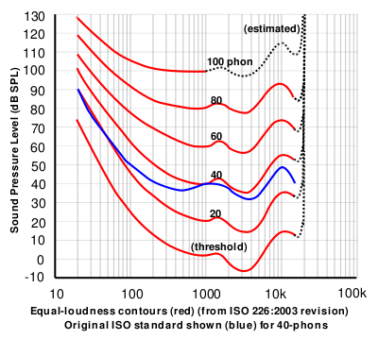
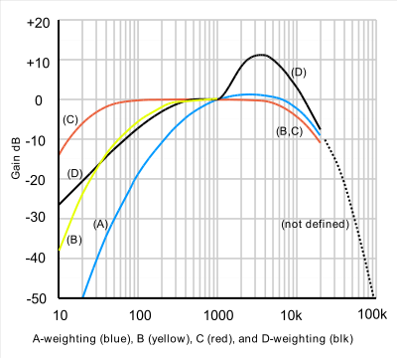
dB SPL and dB A
Iso-loudness contours
A-weighting filter (blue)
Image source: wikipedia
Notes:
http://upload.wikimedia.org/wikipedia/commons/thumb/3/39/Acoustic_weighting_curves_%281%29.svg/400px-Acoustic_weighting_curves_%281%29.svg.png
http://upload.wikimedia.org/wikipedia/commons/thumb/4/47/Lindos1.svg/400px-Lindos1.svg.png

Slide 30
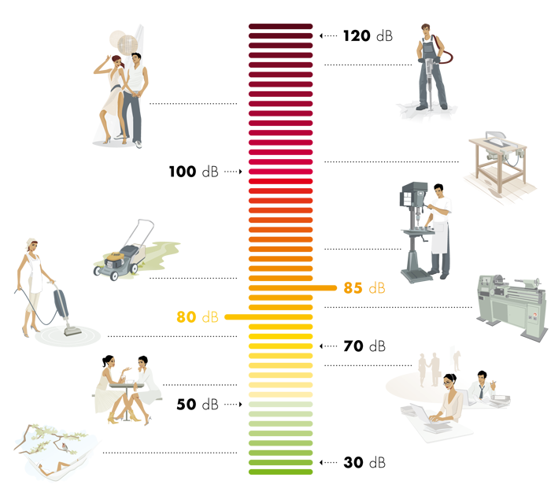
dB A

Slide 31
dB HL (Hearing Level)
Threshold level of auditory sensation measured in a subject or patient, above “expected threshold” for a young, healthy adult.
-10 - 25 dB HL: normal hearing
25 - 40 dB HL: mild hearing loss
40 - 55 dB HL: moderate hearing loss
55 - 70 dB HL: moderately severe hearing loss
70 – 90 dB HL: severe hearing loss
> 90 dB HL: profound hearing loss
http://auditoryneuroscience.com/acoustics/clinical_audiograms

