Slide 1

Periodicity and Pitch
Auditory Neuroscience 3
Prof. Jan Schnupp
wschnupp@cityu.edu.hk
http://auditoryneuroscience.com

Slide 2
Pitch
The American National Standards Institute (ANSI, 1994) defines pitch as “that auditory attribute of sound according to which sounds can be ordered on a scale from low to high.”
… But which way is up?

Slide 3

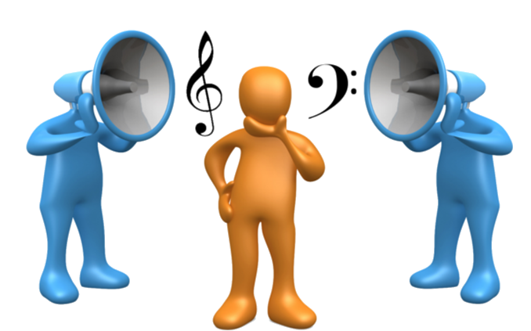
Pitch also plays a role in
auditory scene analysis
http://auditoryneuroscience.com/topics/double-vowels

Slide 4
How pitch perception does NOT work.
http://auditoryneuroscience.com/topics/basilar-membrane-motion-0-frequency-modulated-tone

Slide 5
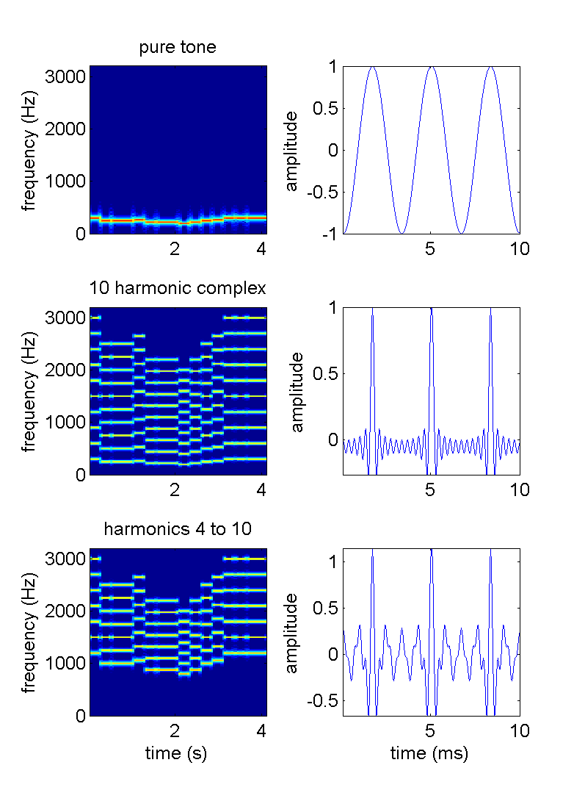

Missing Fundamental Sounds
http://auditoryneuroscience.com/topics/missing-fundamental

Slide 6
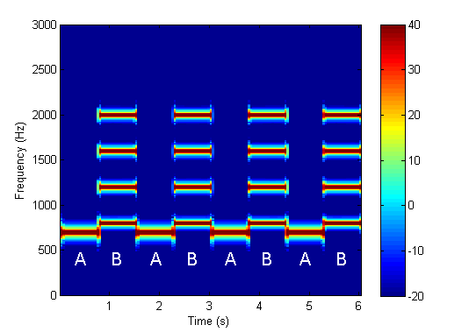
Counter-intuitive Missing Fundamental
http://auditoryneuroscience.com/topics/why-missing-fundamental-stimuli-are-counterintuitive

Slide 7
Measuring Pitch: a Perceptual Quality
http://auditoryneuroscience.com/topics/pitch-matching

Slide 8
Periodicity and Harmonic Structure

Slide 9


The Pitch of “Complex” Sounds (Examples)
Notes:
Fix AM sound

Slide 10
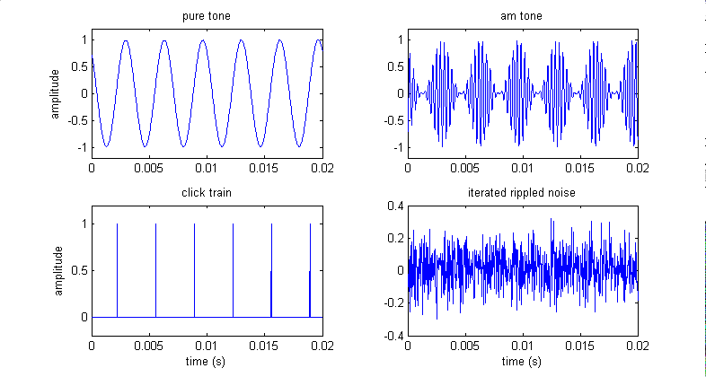
The Periodicity of a Signal is a Major Determinant of its Pitch
τ
τ
Iterated rippled noise can be made more or less periodic by increasing or decreasing the number of iterations. The less periodic the signal, the weaker the pitch.

Slide 11
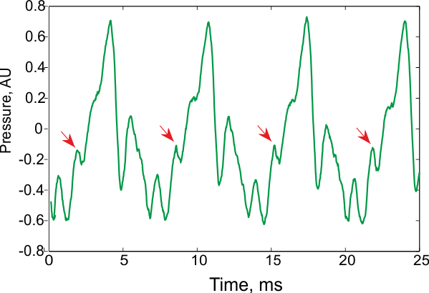
AN Figure 3.2
Four periods of the vowel /a/ from natural speech. The periods are similar but not identical

Slide 12
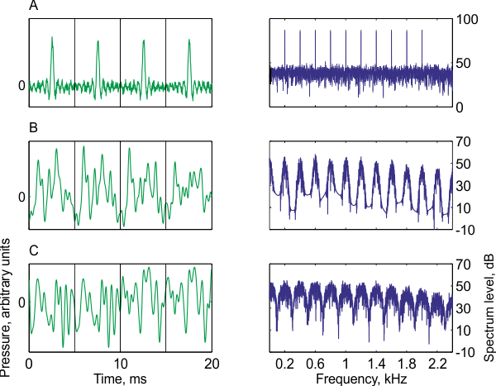
AN Figure 3.3
Three examples of nonperiodic (quasi-periodic) sounds that evoke a strong pitch perception.

Slide 13
Periodic Sounds Always Have “Harmonic Structure”

Slide 14
Autocorrelation

Slide 15
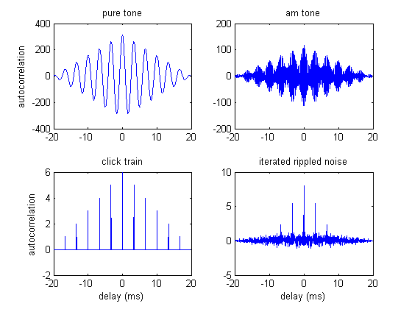
Stimulus Autocorrelation
Autocorrelations measure how similar a sound is to a delayed copy of itself.
Periodic sounds have high autocorrelation values when the delay equals the period.
Peaks in the autocorrelation are therefore predictive of perceived pitch, even for missing fundamental stimuli and “quasi-periodic” sounds.
τ
τ

Slide 16
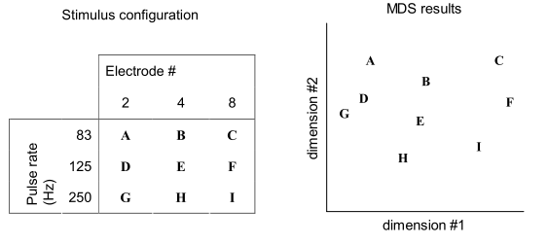
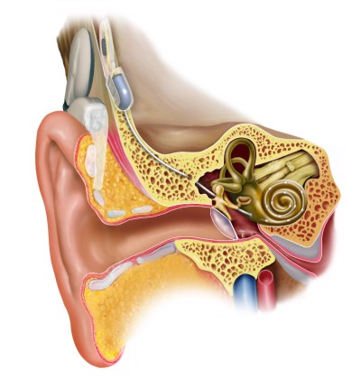
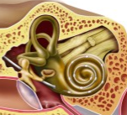
Periodicity Pitch vs Place Pitch
Perceptual multidimensional scaling (MDS) experiment by Tong and colleagues (1983)

Slide 17
Break

Slide 18
Musical Pitch Scales, Consonance and Dissonance

Slide 19
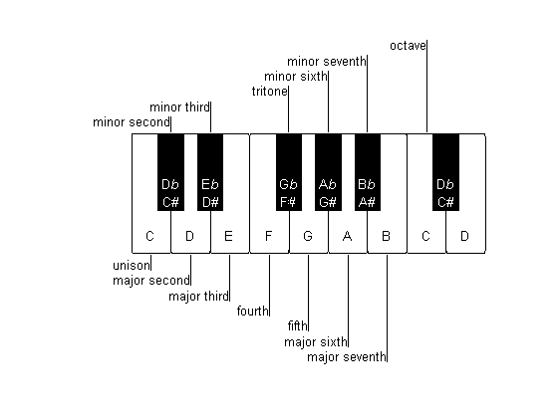
Pitch Scales in Western Music
One octave: double fundamental frequency
12 “semitones” in one octave.
A1 = 55 Hz, A2 = 110 Hz, A3 = 220 Hz, A4 = 440 Hz, …
One semitone increases frequency by 2^{(1/12)} = 1.0595, or ca 6%

Slide 20
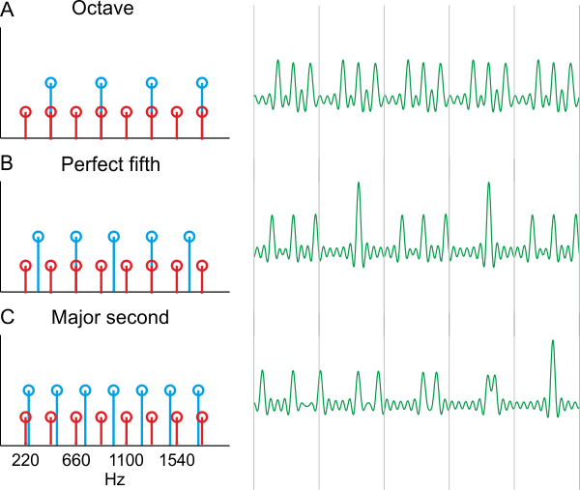
Consonant and Dissonant Intervals
AN Fig 3.4
Fifth = 7 semi tones = F0 interval of 2^{(7/12)} = 1.4983, i.e almost exactly 50% above the fundamental
“Perfect Fifth” = F0 interval of exactly 1.5

Slide 21
Cochlea and Auditory Nerve
Place vs Timing Codes

Slide 22
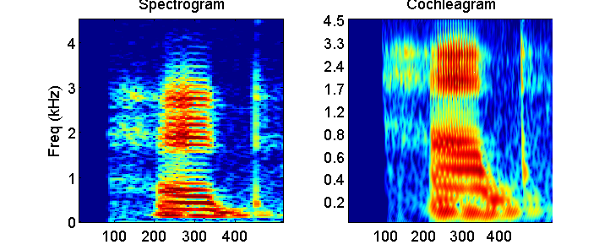
Resolved and
Unresolved Harmonics
Spectrogram of, and basilar membrane response to, the spoken word “head”
http://auditoryneuroscience.com/ear/bm_motion_3

Slide 23
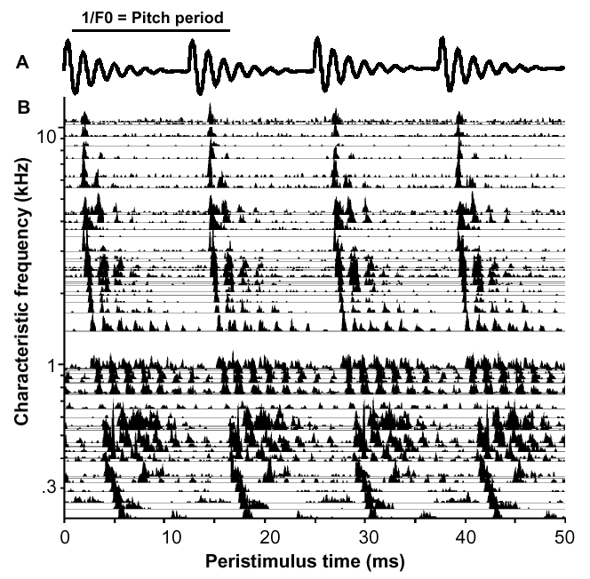
AN Phase Locking to Artificial “Single Formant” Vowel Sounds
Phase locking
to Modulator
(Envelope)
Phase locking
to Carrier
Cariani & Delgutte AN recordings

Slide 24
Periodicity and Pitch Coding in the CNS

Slide 25
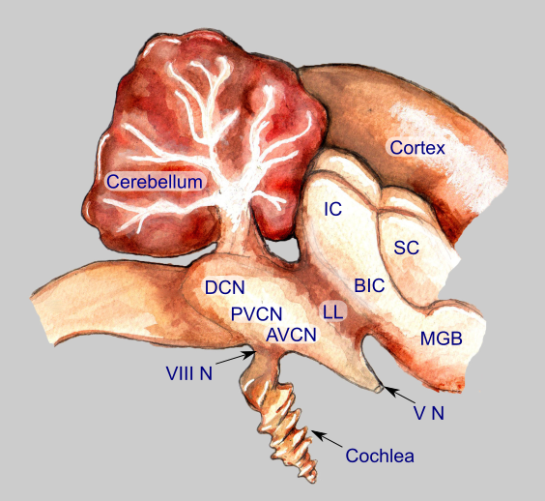
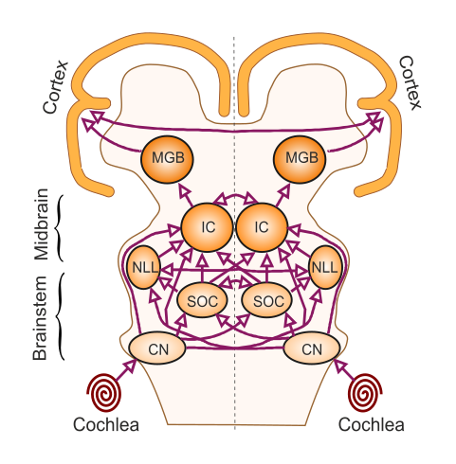
The Auditory Pathway
VIII N: 8th cranial (vestibulo-cochlear) nerve
AVCN, PVCN, DCN: antero-, posteroventral&
dorsal cochlear nuclei;
LL: lateral lemniscus;
IC, inferior colliculus;
BIC: brachium of the inferior colliculus
MGB, medial geniculate body.
CN, cochlear nuclei;
SOC, superior olivary complex;
NLL, nuclei of the lateral lemniscus;
IC, inferior colliculus;
MGB, medial geniculate body.

Slide 26
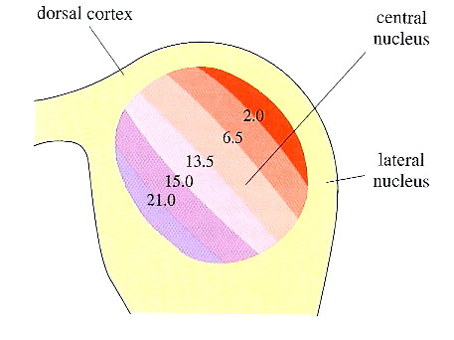
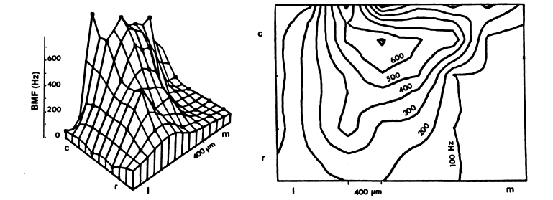
Encoding of Envelope Modulations in the Midbrain
Neurons in the midbrain or above show much less phase locking to AM than neurons in the brainstem.
Transition from a timing to a rate code.
Some neurons have bandpass MTFs and exhibit “best modulation frequencies” (BMFs).
Topographic maps of BMF may exist within isofrequency laminae of the ICc, (“periodotopy”).
Schreiner & Langner J Neurohys 1988

Slide 27
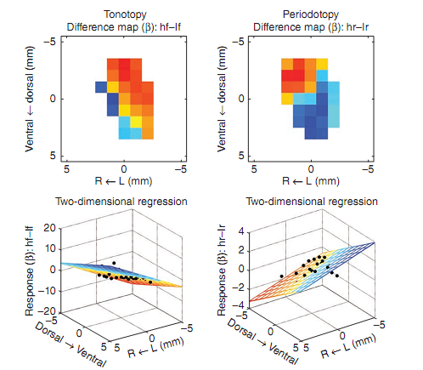
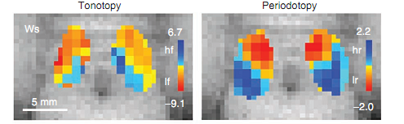
Periodotopic maps via fMRI
Baumann, Petkov, Griffiths, Rees Nat Neurosci 2011
described periodotopic maps in monkey IC obtained with fMRI.
They used stimuli from 0.5 Hz (infra-pitch) to 512 Hz (mid-range pitch).
Their sample size is quite small (3 animals – 20-30 voxels/IC)
The observed orientation of their periodotopic map (medio-dorsal to latero-ventral for high to low) appears to differ from that described by Schreiner & Langner (1988) in the cat (predimonantly caudal to rostral)
http://www.ncbi.nlm.nih.gov/pmc/articles/PMC3068195

Slide 28
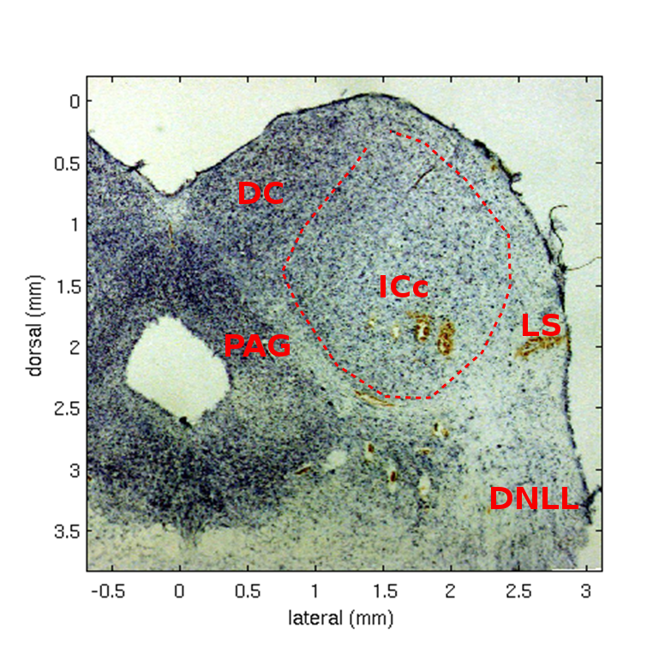
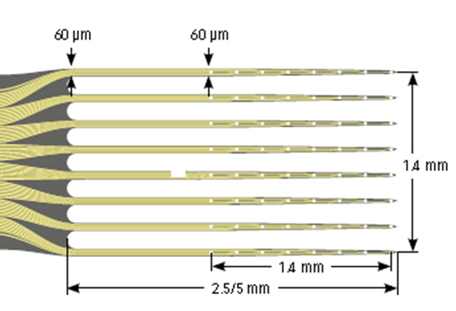
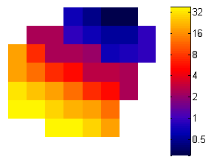
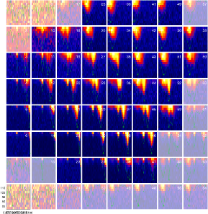
Mapping Functional Anatomy of ICc
Schnupp, Garcia-Lazaro & Lesica
Front Neural Circuits 2015, In press

Slide 29
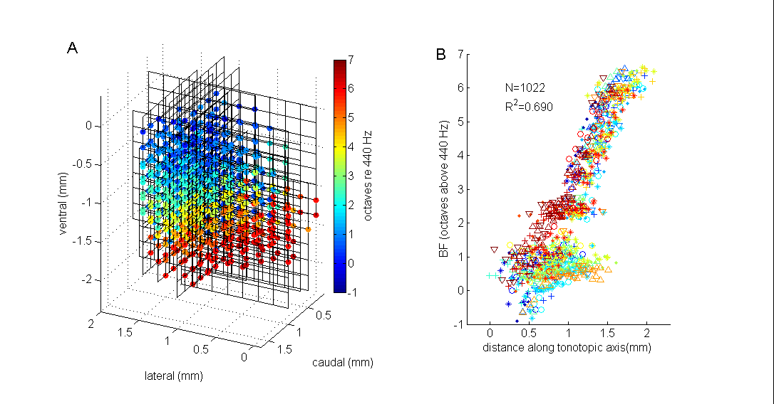
Tonotopy in Inferior Colliculus

Slide 30
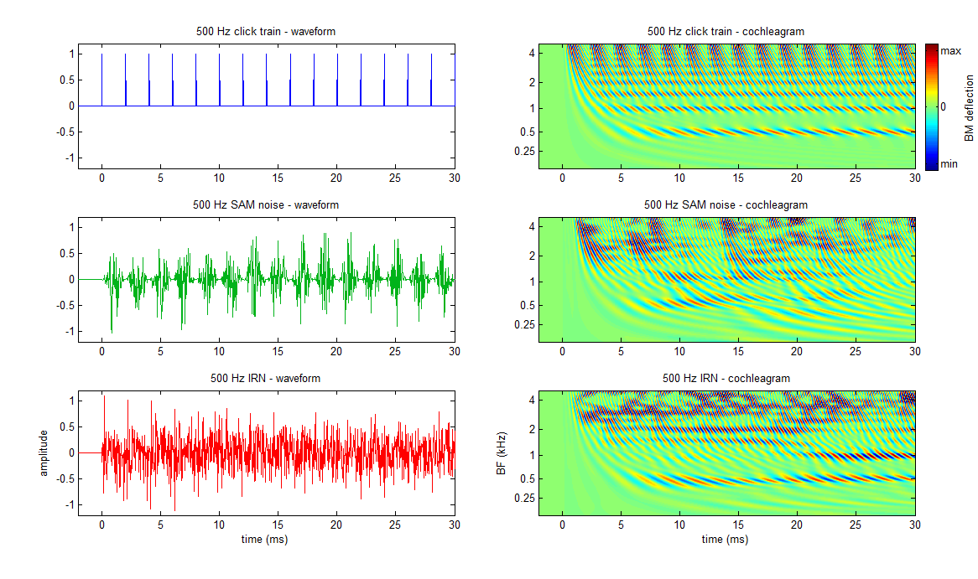
3 Flavours of (Quasi-)Periodic Sounds

Slide 31
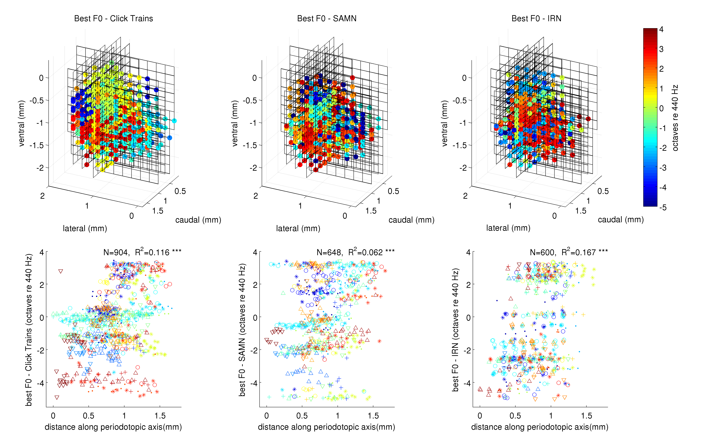
Periodotopy in IC?

Slide 32
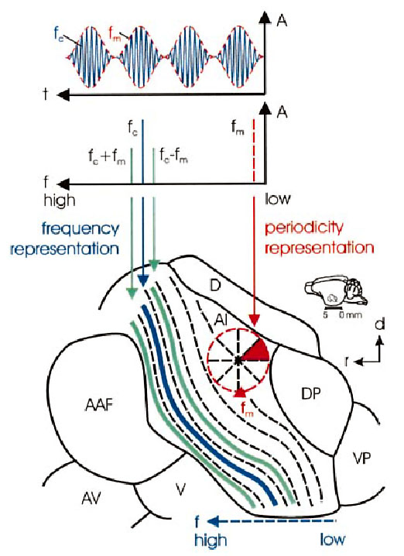
Proposed Periodotopy in Gerbil A1
Schulze, Hess, Ohl, Scheich, 2002 EJN 15:6

Slide 33
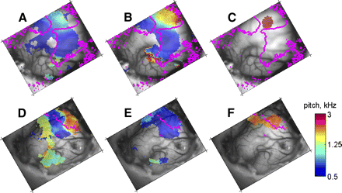
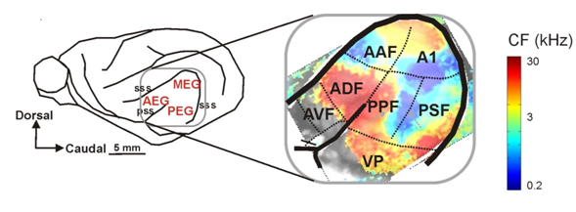
Periodotopy inconsistent in ferret cortex
SAM tones
hp Clicks
hp IRN
animal 1
animal 2
Nelken, Bizley, Nodal, Ahmed, Schnupp, King (2008) J. Neurophysiol 99(4)

Slide 34
Break

Slide 35
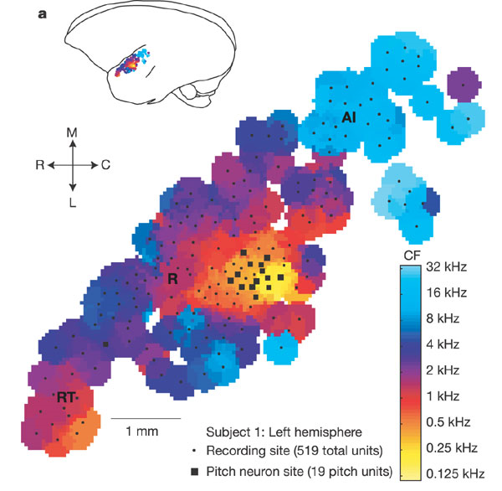
A pitch area in primate cortex?
Fig 2 of Bendor & Wang, Nature 2005

Slide 36
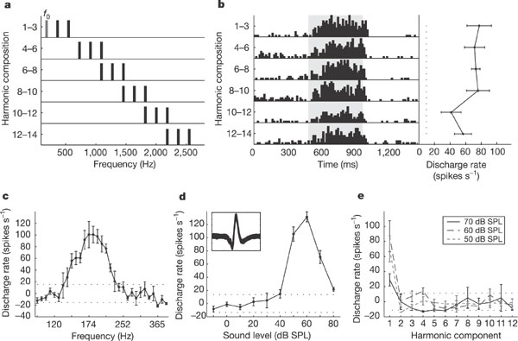
A pitch sensitive neuron in marmoset A1?
Apparently pitch sensitive neurons in marmoset A1.
Fig 1 of Bendor & Wang, Nature 2005

Slide 37
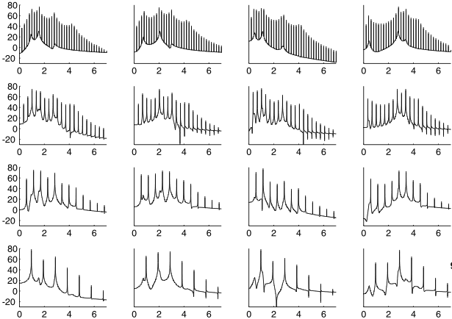
Mapping cortical sensitivity to sound features
Location
45°
15°
-15°
-45°
200
336
Pitch (Hz)
565
951
/ɑ/
/ɛ/
/u/
/i/
Timbre
Bizley, Walker, Silverman, King, Schnupp, J Neurosci, 2009
Notes:
One hypothesis that’s been put forth is that different areas of auditory cortex may be specialized for extracting different features of sound.
37

Slide 38
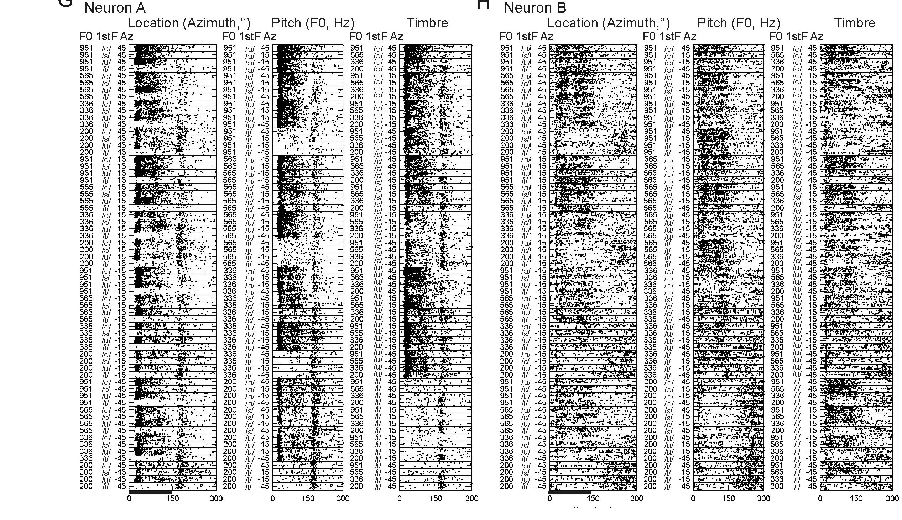
Responses to Artificial Vowels
Bizley, Walker, Silverman, King, Schnupp, J Neurosci 2009

Slide 39
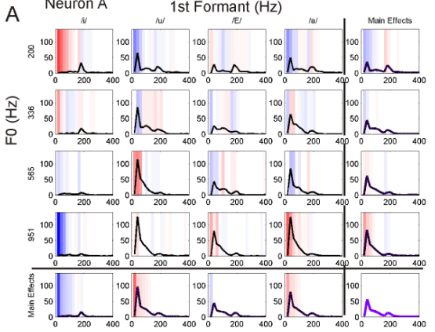
Joint Sensitivity to Formants and Pitch
Vowel type (timbre)
Pitch (Hz)
Bizley, Walker, Silverman, King & Schnupp - J Neurosci 2009

Slide 40
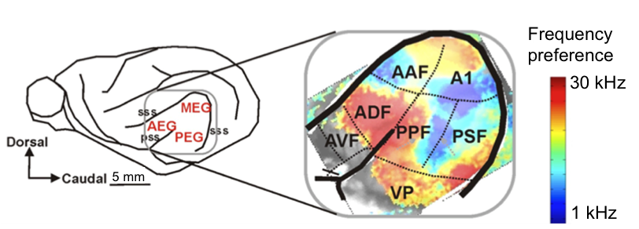
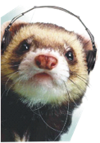
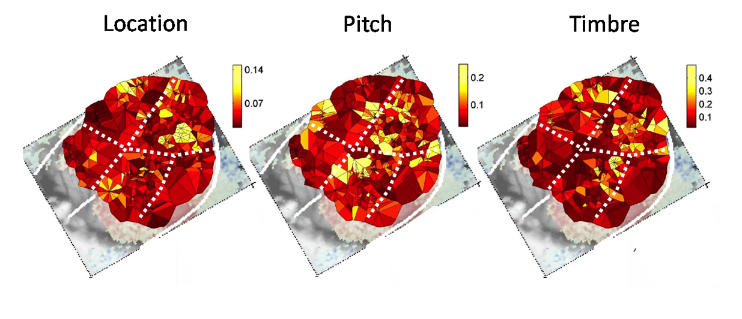
Mapping cortical sensitivity to sound features
Location
Pitch
Timbre
Nelken et al., J Neurophys, 2004
Neural
sensitivity
Bizley, Walker, Silverman, King & Schnupp - J Neurosci 2009
Notes:
One hypothesis that’s been put forth is that different areas of auditory cortex may be specialized for extracting different features of sound.
40

Slide 41
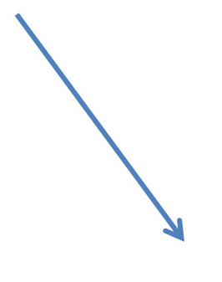
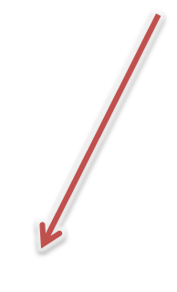
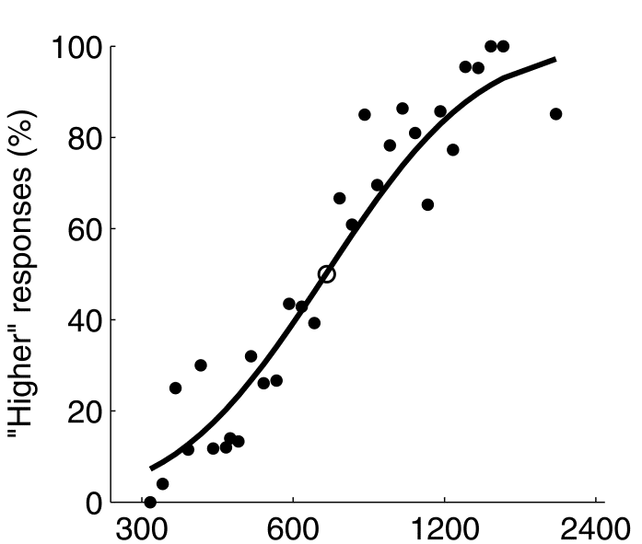
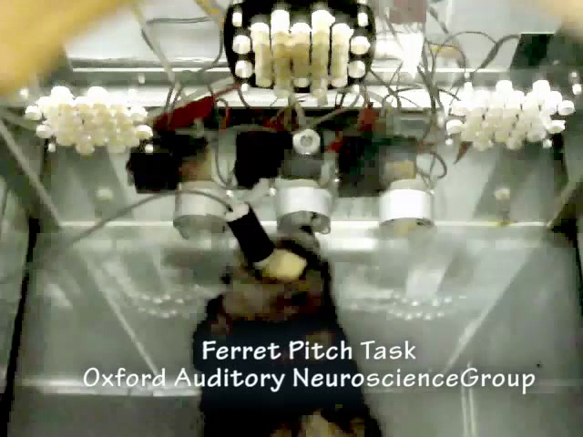
Can ferrets discriminate pitch increases from decreases?
low
high
♩
♩
♩
♩
Target pitch (Hz)
Walker, Hart-Schnupp, King, Schnupp, Bizley (2009) J Acoust Soc Am.
Bizley, Walker, King, Schnupp. (2013) J Acoust Soc Am.

Slide 42
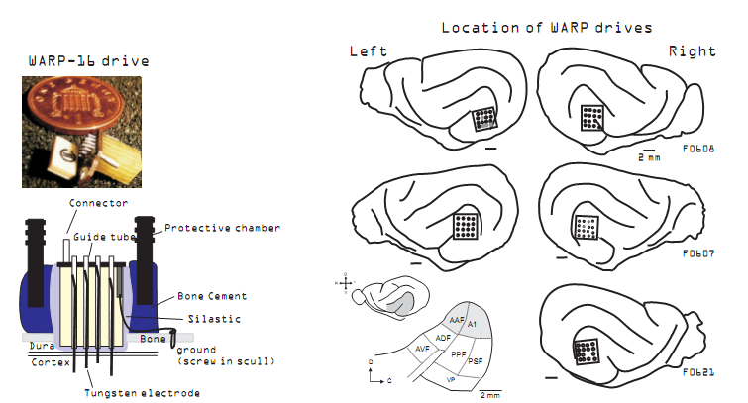
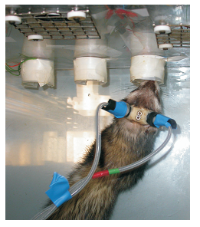
Awake behaving ferret recordings
Bizley, Walker, King & Schnupp –
Current Biology 2013

Slide 43
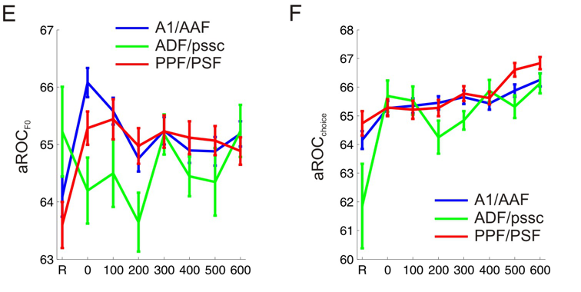
Presented vs Perceived Stimuli
Bizley, Walker, King & Schnupp – under review

Slide 44
Further Reading
Auditory Neuroscience – Chapter 3
Schnupp JW, Bizley JK. (2010) On Pitch, the Ear and the Brain of the Beholder. J Neurophysiol.

