Slide 1

Spatial Hearing
Auditory Neuroscience 4
Prof. Jan Schnupp
wschnupp@cityu.edu.hk
http://auditoryneuroscience.com

Slide 2
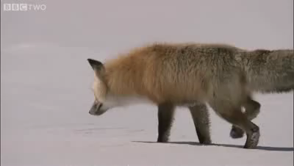

Slide 3
Representing the visual world in the brain
Society for Neuroscience Brain Facts

Slide 4
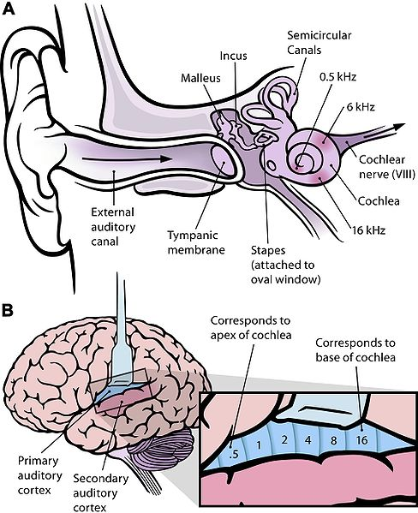
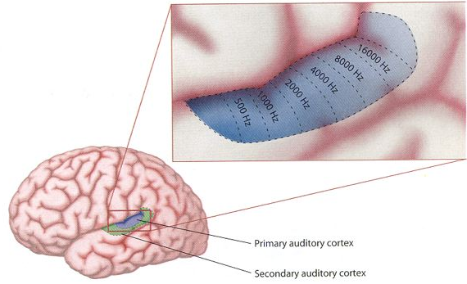
Organization of the auditory pathway
0.5 kHz
6 kHz
16 kHz

Slide 5
Localizing a sound in space: binaural cues
Δ µs
Right ear
Δ dB
Pressure
Left ear
Time
Binaural disparity cues

Slide 6
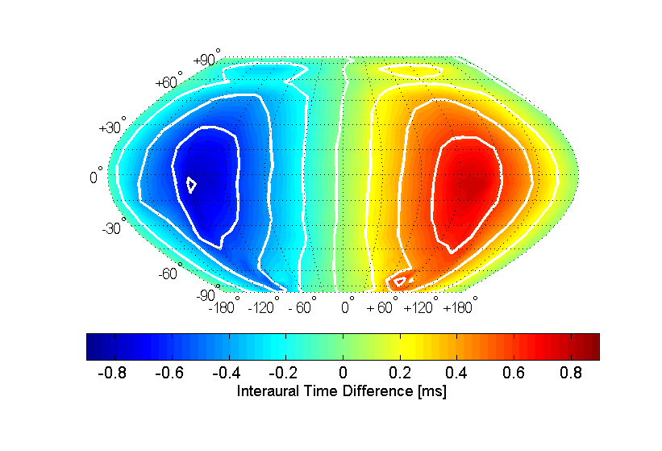

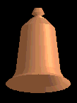
Interaural Time Difference (ITD) Cues
ITD
ITDs are powerful cues to sound source direction, but they are ambiguous (“cones of confusion”)

Slide 7
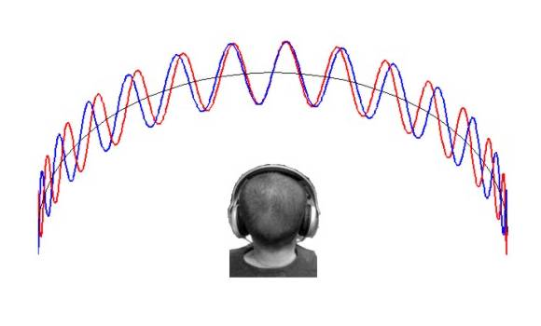
Binaural Beats

Slide 8
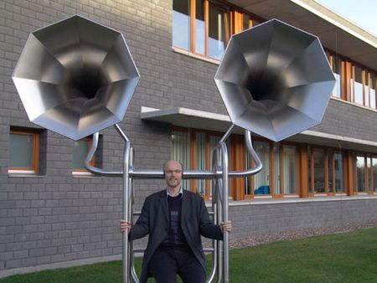
Head size matters….
∼20 cm
≅0.6 ms

Slide 9
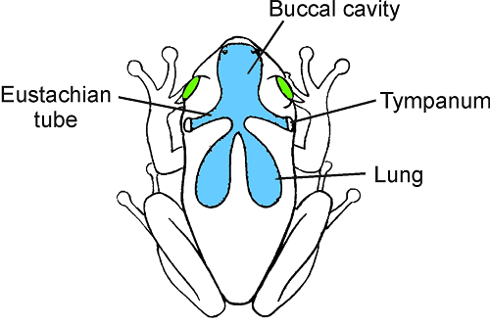
In species with pressure-gradient receivers, sounds can reach both sides of the eardrum
Sound
However, mammalian ears are not pressure-gradient receivers

Slide 10
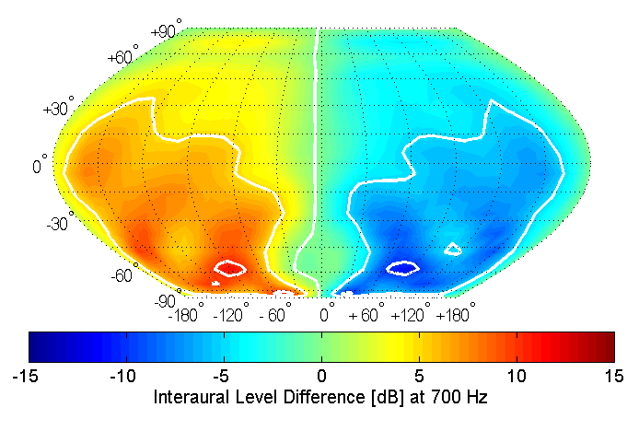
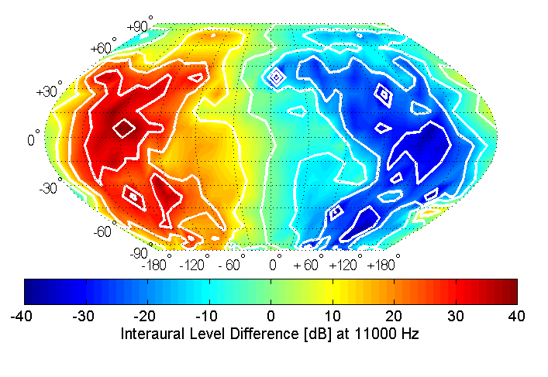
Interaural Level Cues (ILDs)
ILD at 700 Hz
ILD at 11000 Hz
Unlike ITDs, ILDs are highly frequency dependent. At higher sound frequencies ILDs tend to become larger, more complex, and hence potentially more informative.

Slide 11
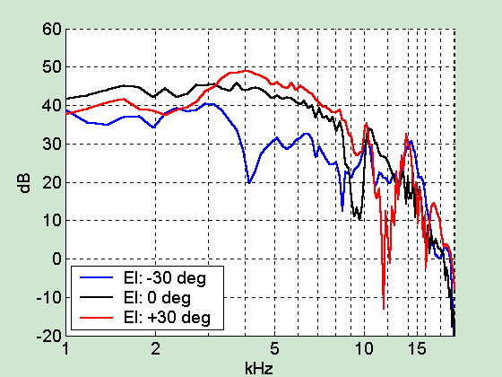
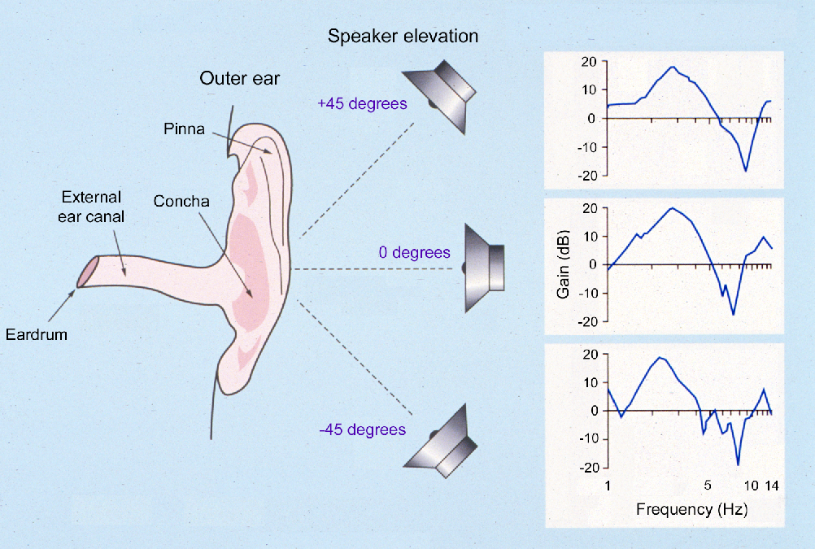
Spectral (Monaural) Cues

Slide 12
Duplex theory of sound localization
low frequency sounds are localized using interaural time differences
high frequency sounds are localized primarily on the basis of interaural level differences
(Note that there is quite a lot of support for this theory, but it would be a mistake to think that this is an “iron rule” to which there are no exceptions.)

Slide 13
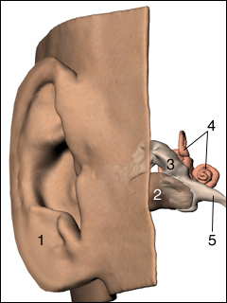
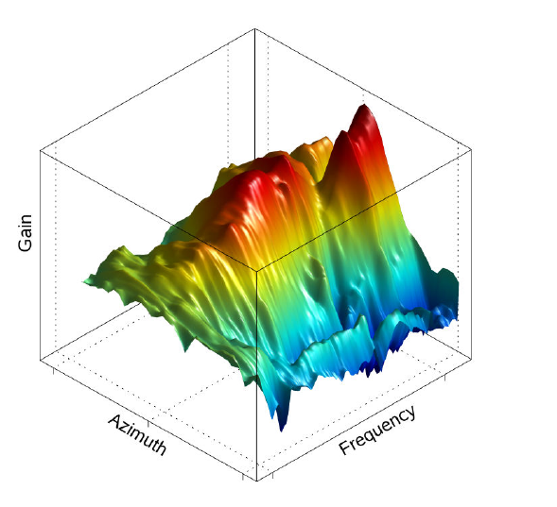

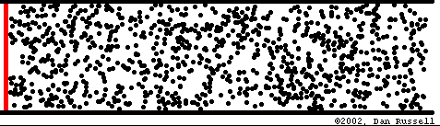
Ambiguities in sound localization: spectral cues
How does the brain know whether particular spectral patterns reflect the way the external ear filters the sound or are properties of the sound itself?
Notes:
If we imagine a man standing next to a speaker and measure sound arriving at both ears, the sound will be louder in the ear nearest the speaker, and the difference in loudness between the ears is called an ILD.

Slide 14
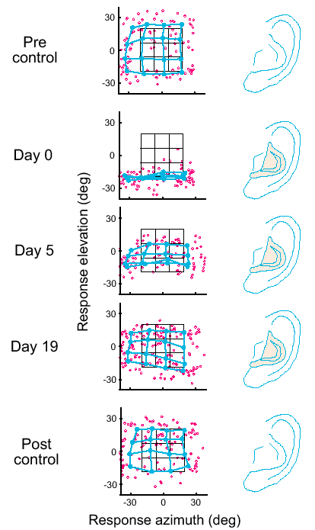
Adapting to Changes in Spectral Cues
Hofman et al. made human volunteers localize sounds in the dark, then introduced plastic molds to change the shape of the concha. This disrupted spectral cues and led to poor localization, particularly in elevation.
Over a prolonged period of wearing the molds, (up to 3 weeks) localization accuracy improved.

Slide 15
Break

Slide 16
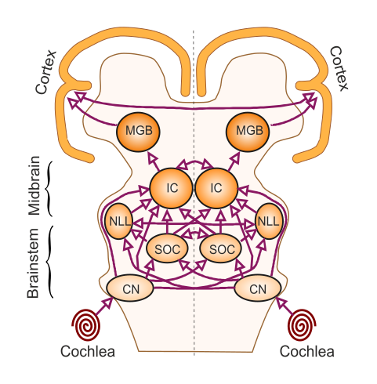
The auditory pathway
CN, cochlear nucleus
SOC, superior olivary complex
NLL, nuclei of the lateral lemniscus
IC, inferior colliculus
MGB, medial geniculate body

Slide 17
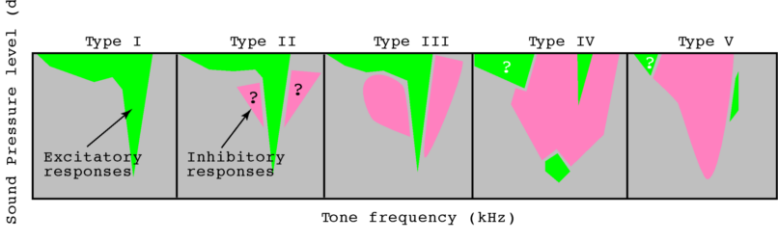
Neurons in the dorsal cochlear nucleus can detect spectral localization cues

Slide 18
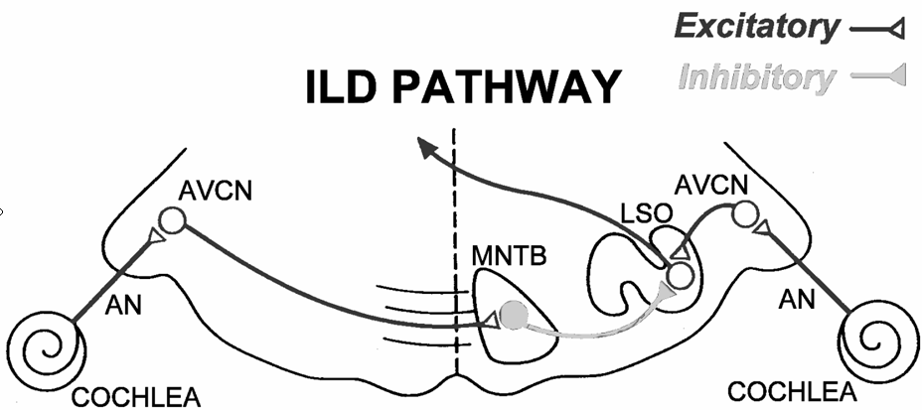
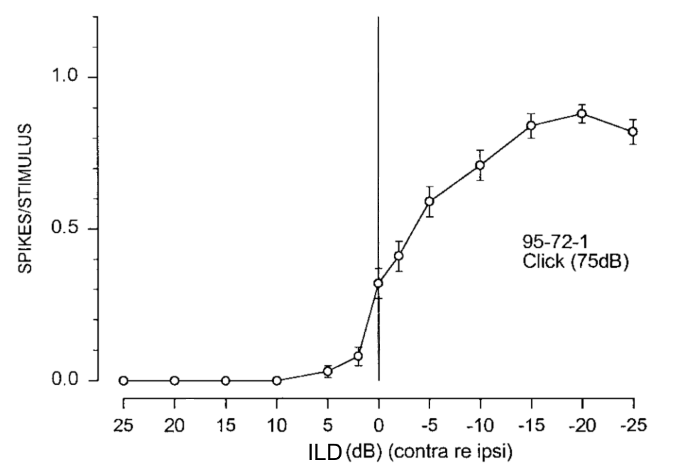
EI neuron

Slide 19
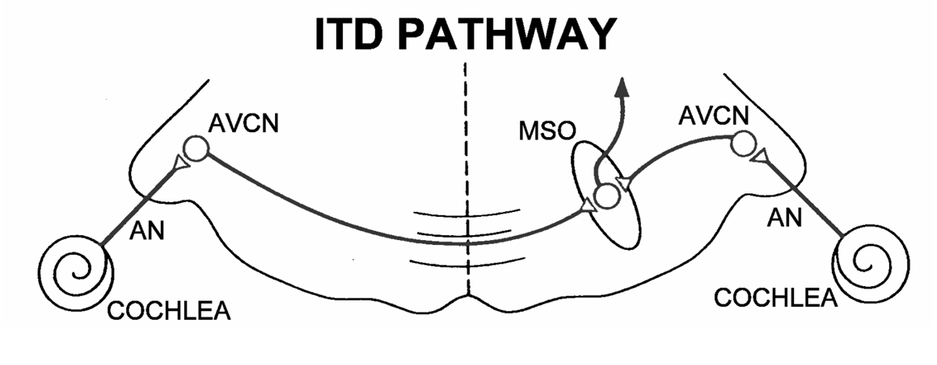
EE neuron

Slide 20
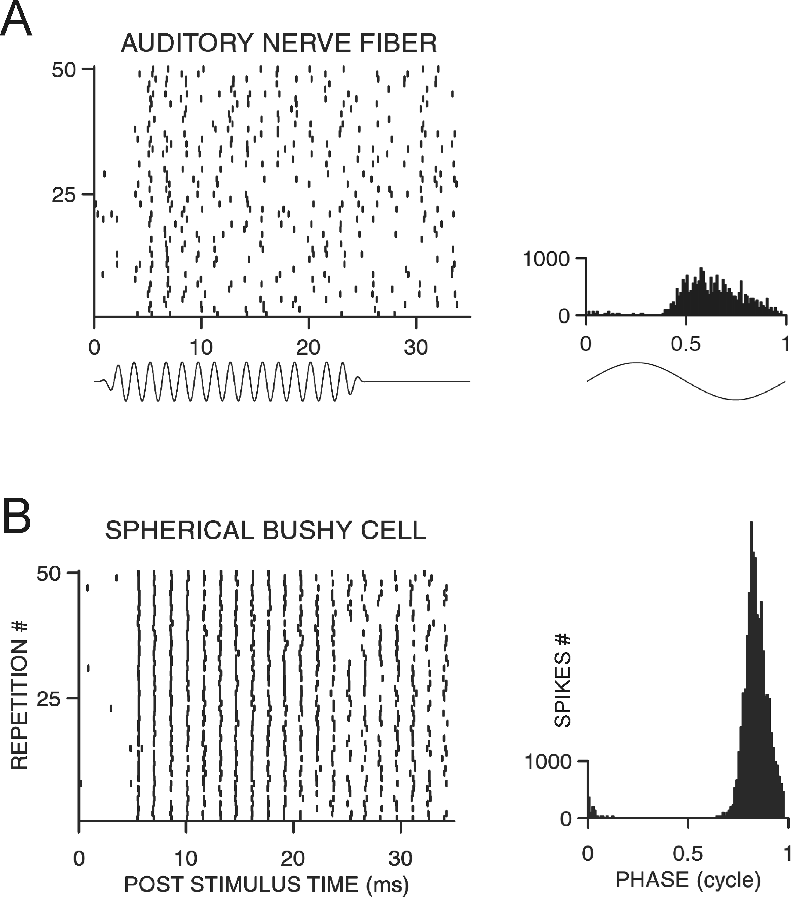
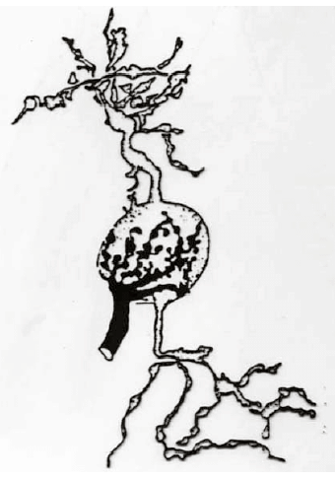
Phase locking improves in the cochlear nucleus
Spherical
bushy
cell
Endbulb
of Held
Auditory nerve
fiber

Slide 21
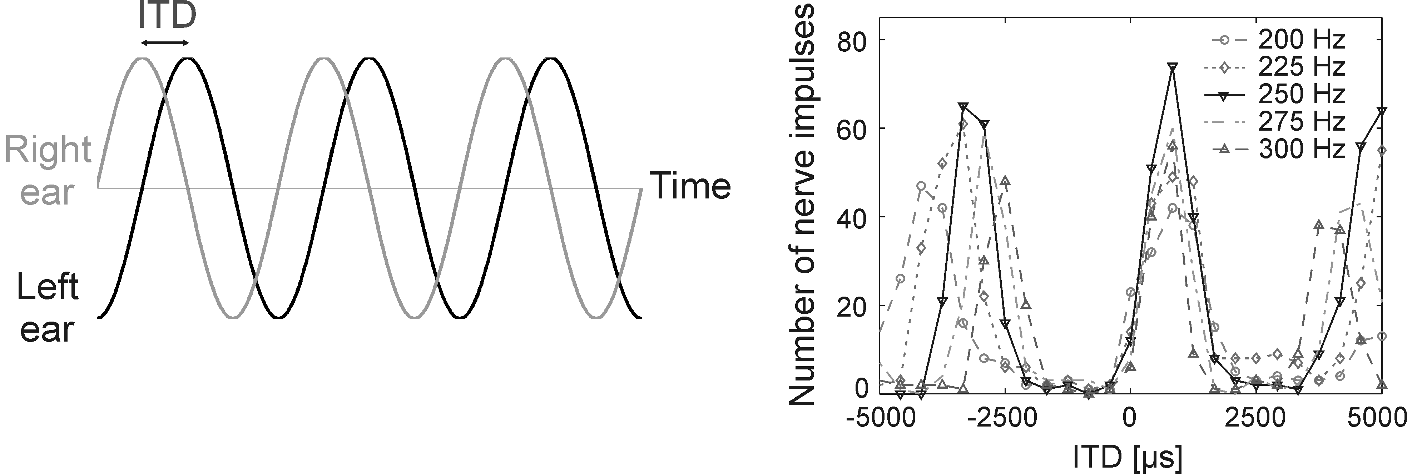
MSO neurons can detect interaural time (phase) differences

Slide 22
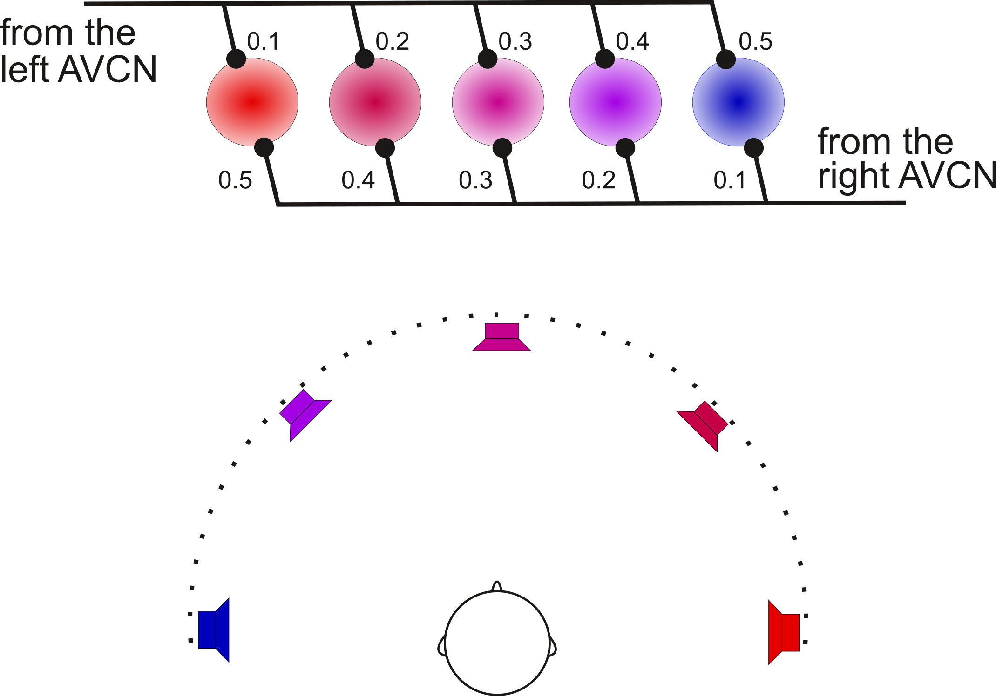
The Jeffress model: mapping ITDs in the brain?

Slide 23
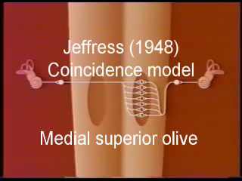
The Jeffress model: mapping ITDs in the brain?
Tom Yin

Slide 24
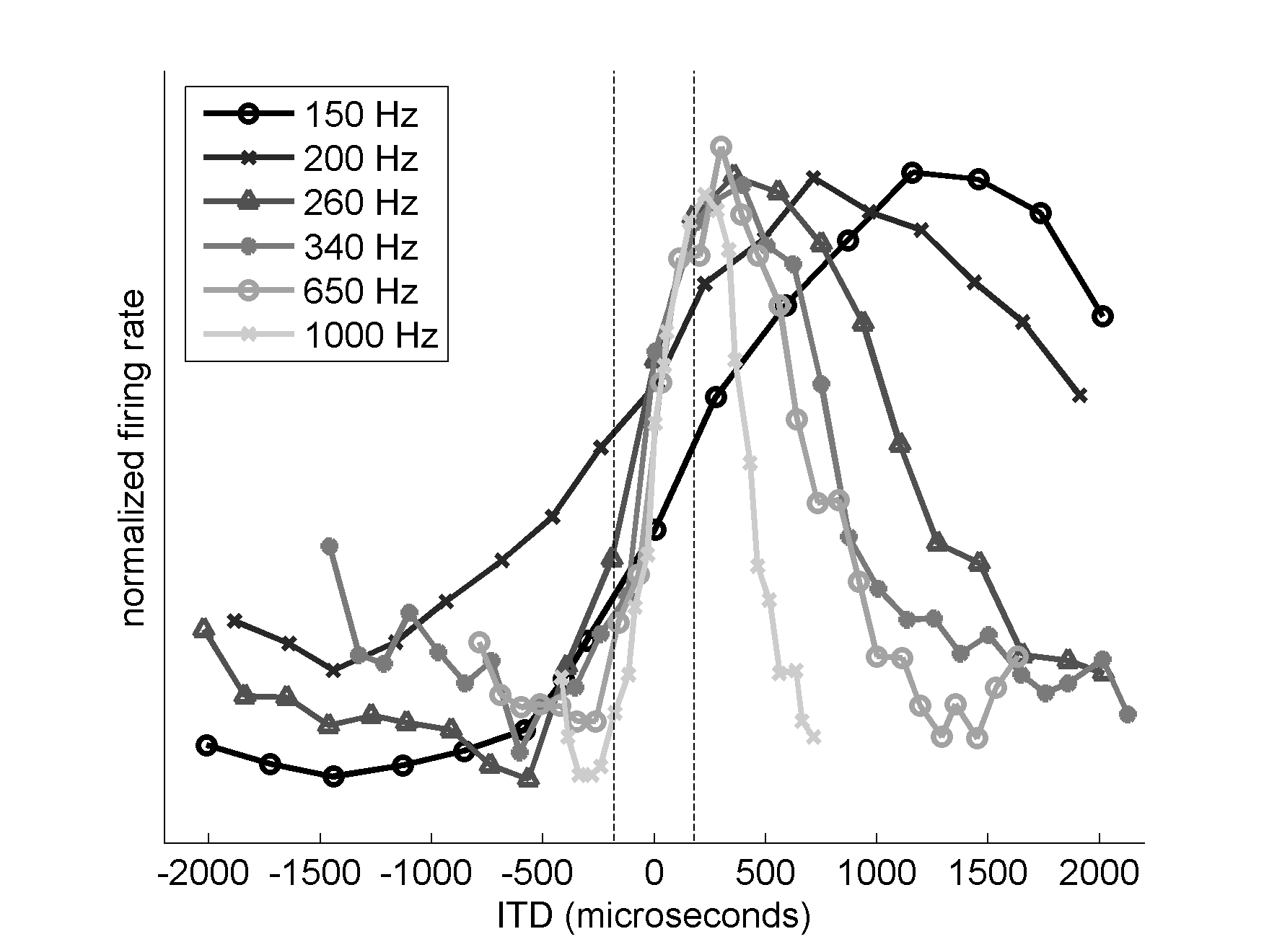
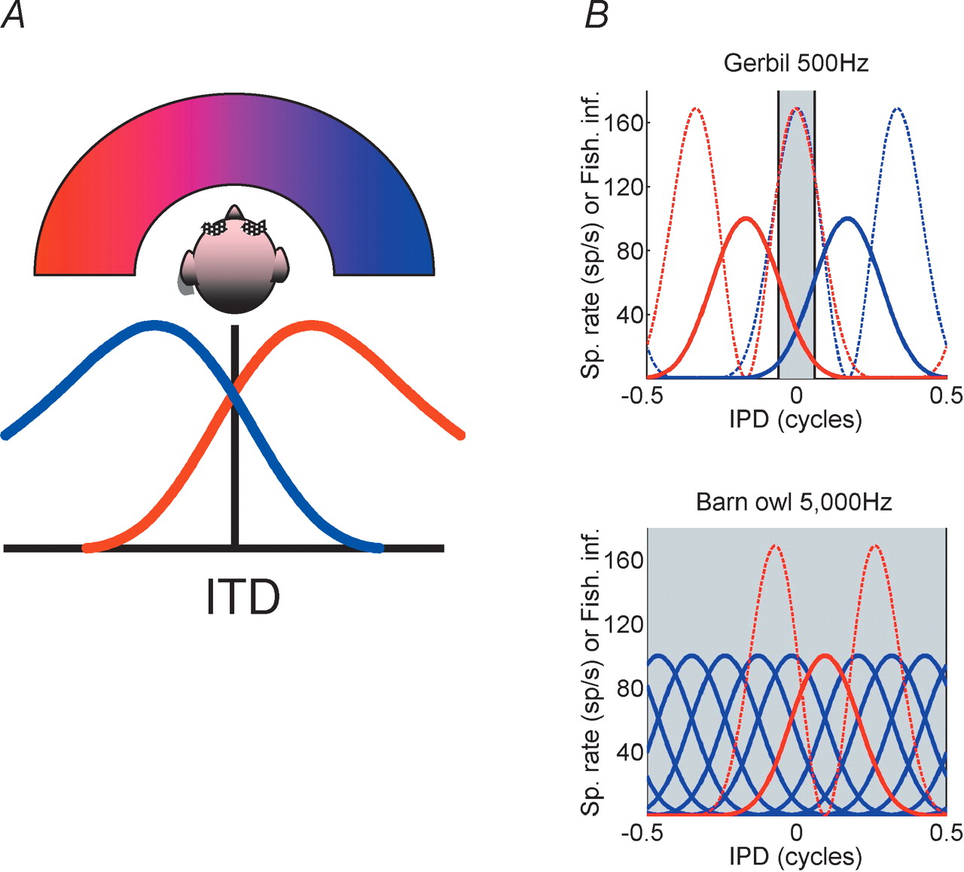

ITD tuning varies with sound frequency: no map?
McAlpine and colleagues

Slide 25
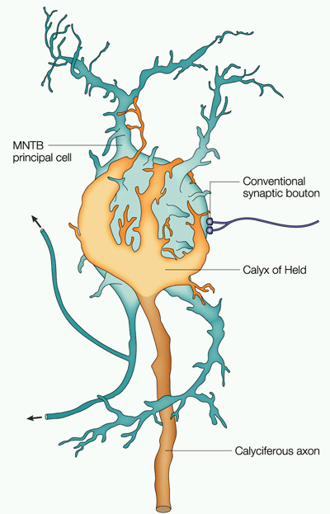
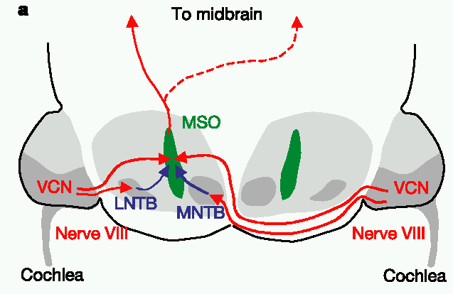
The Calyx of Held
MNTB relay neurons receive their input via very large calyx of Held synapses.
These secure synapses would not be needed if the MNTB only fed into “ILD pathway” in the LSO.
MNTB also provides precisely timed inhibition to MSO.

Slide 26
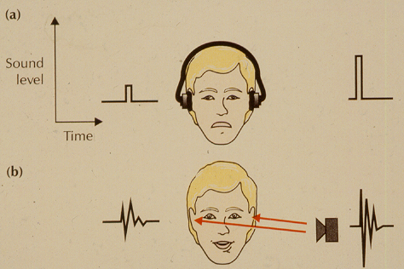
Measuring auditory localization performance
10-20 μsec
1-2 degrees

Slide 27
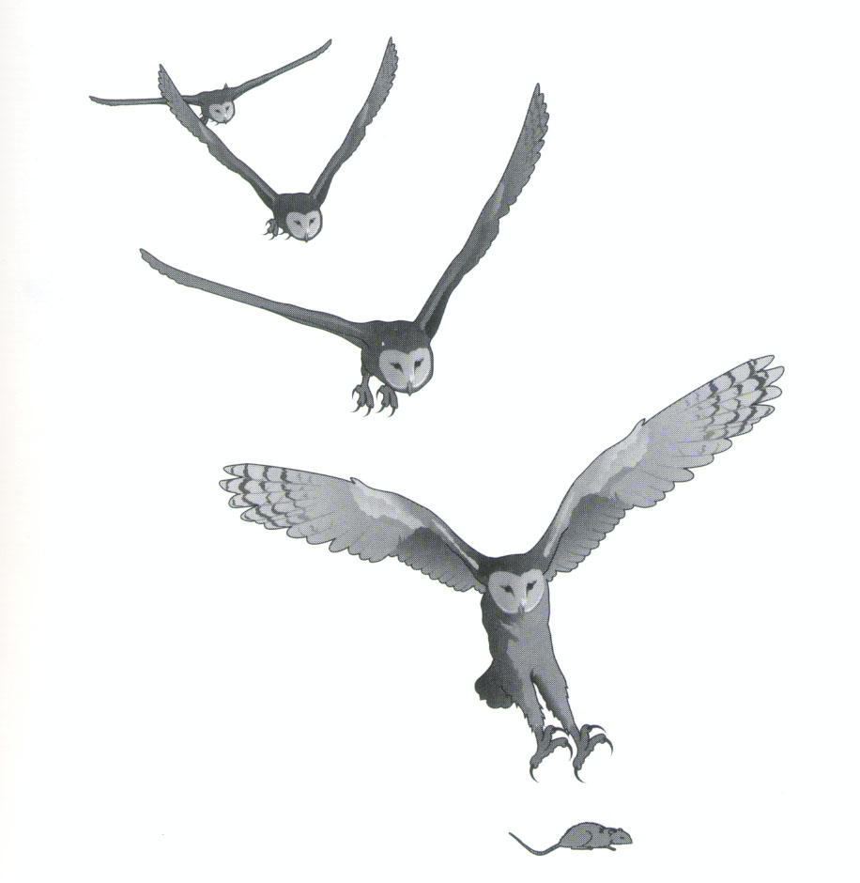
Spatial hearing in barn owls
Knudsen and colleagues

Slide 28
Binaural Cues in the Barn Owl
Barn owls have highly asymmetric outer ears, with one ear pointing up, the other down. Consequently, at high frequencies, barn owl ILDs vary with elevation, rather than with azimuth (D). Consequently ITD and ILD cues together form a grid specifying azimuth and elevation respectively.

Slide 29
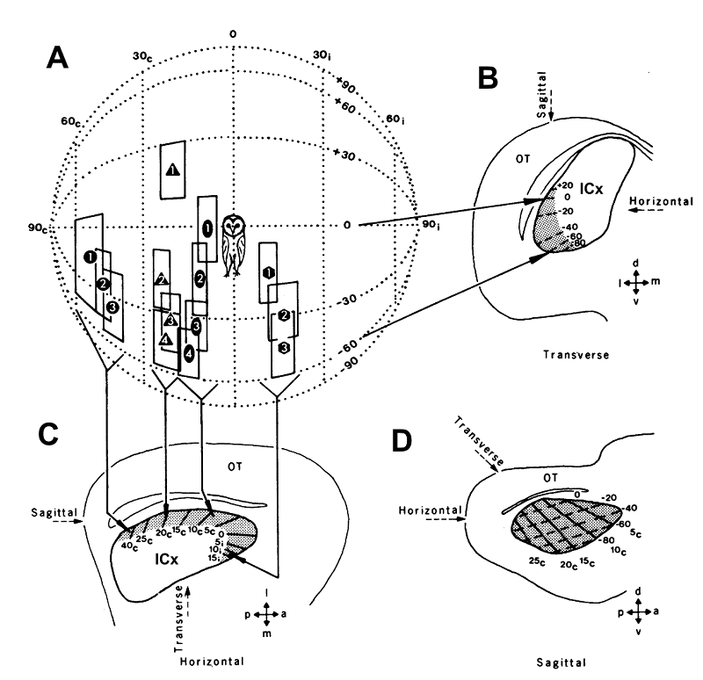
A map of auditory space in the barn owl’s midbrain
Knudsen & Konishi

Slide 30
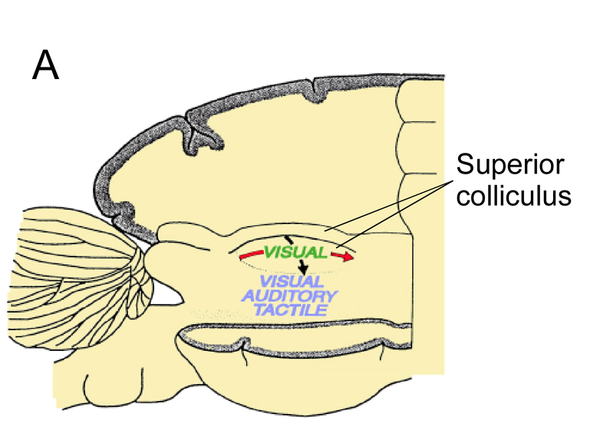
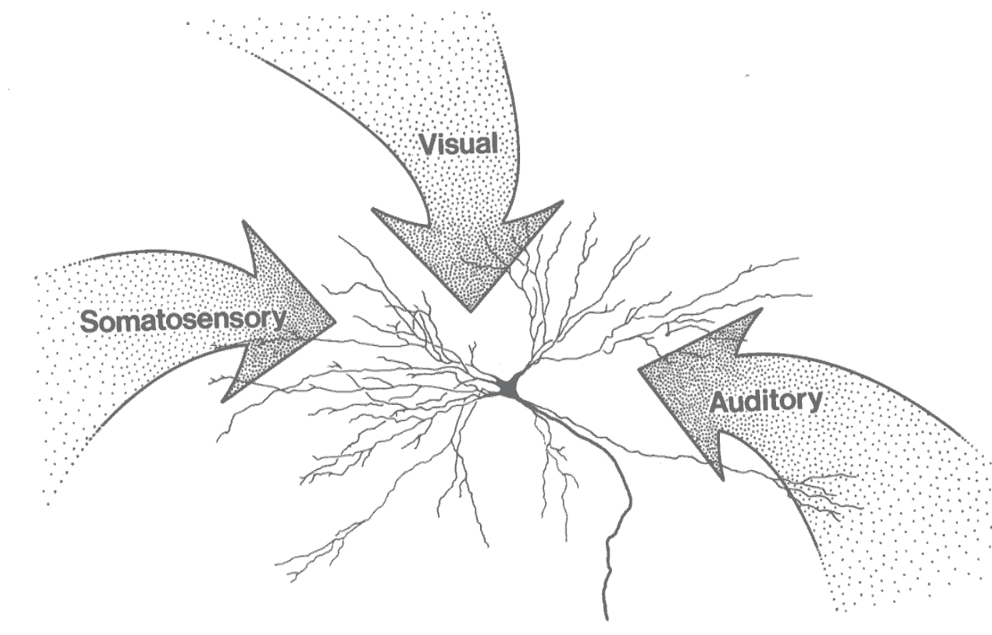
Sensory map registration in the mammalian superior colliculus

Slide 31
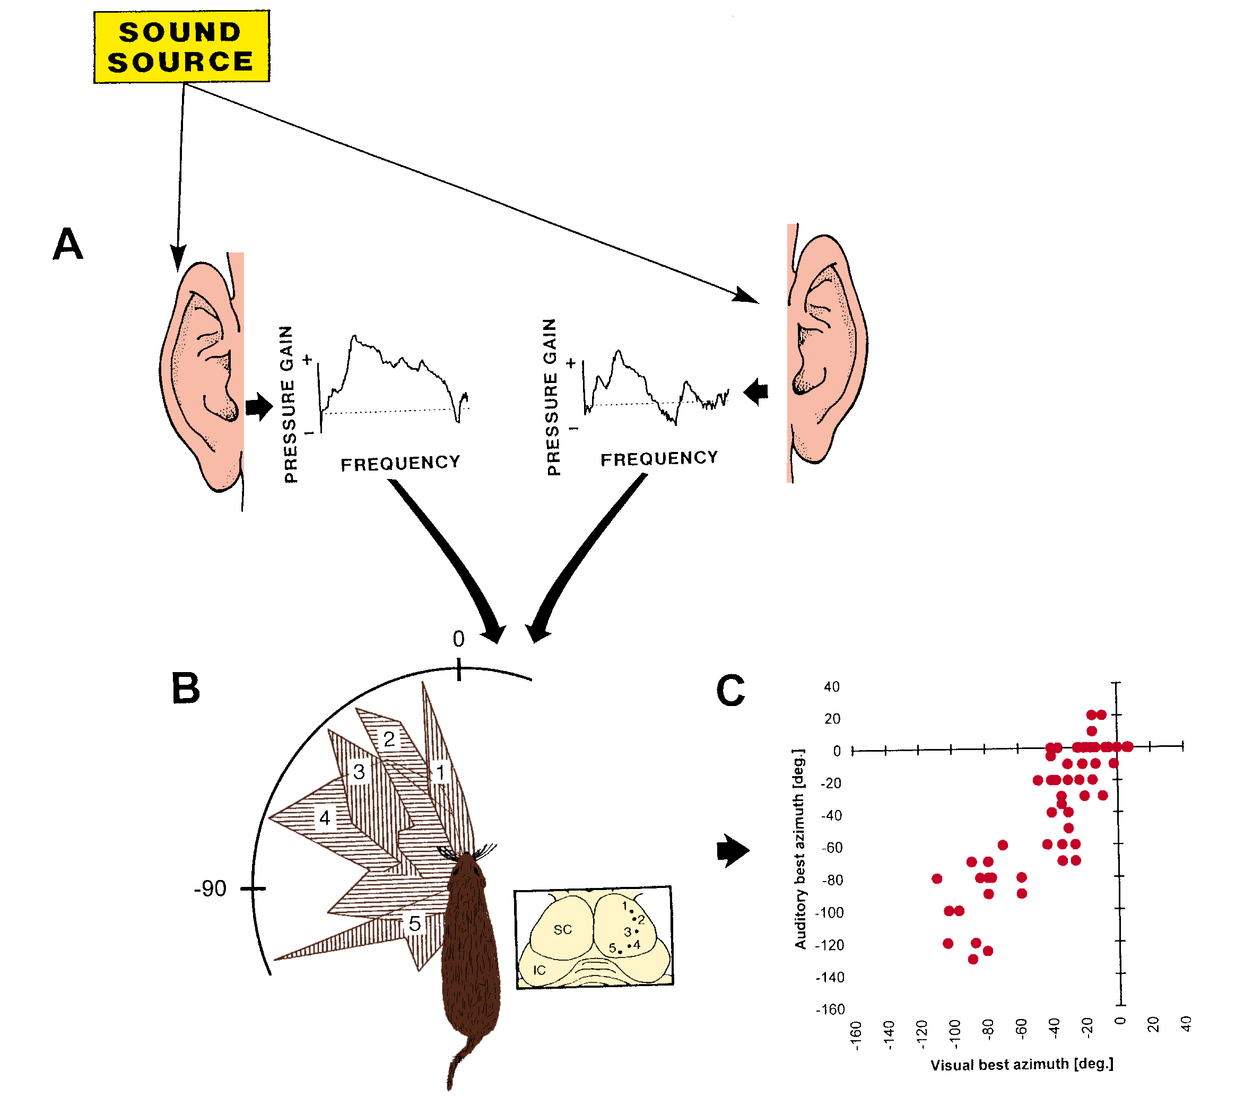
Sensory map registration in the mammalian superior colliculus
Auditory best azimuth (deg)
King and colleagues
Visual best azimuth (deg)

Slide 32
Break

Slide 33
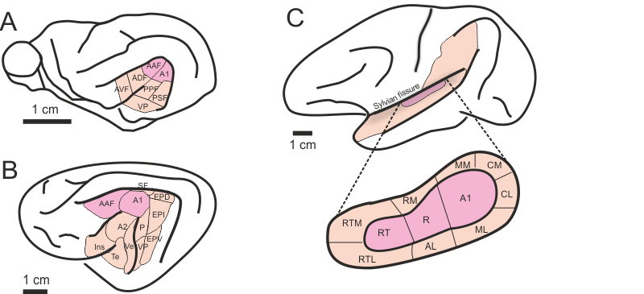
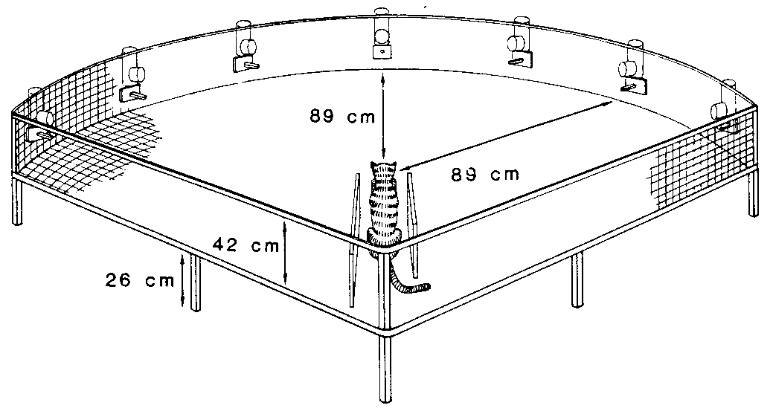
Lesion studies show that the auditory cortex is required for sound localization

Slide 34
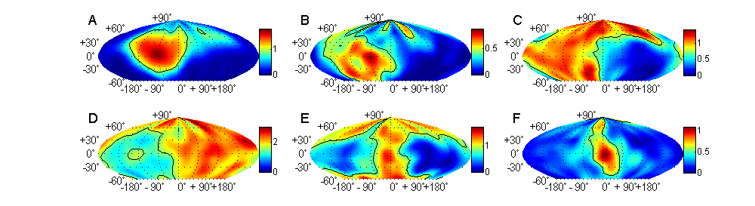
Spatial receptive fields in the auditory cortex
Spatial tuning is heterogeneous, but most neurons prefer contralateral locations
No map of spatial location
Comparison of activity of neuronal populations tuned to each side of space

Slide 35
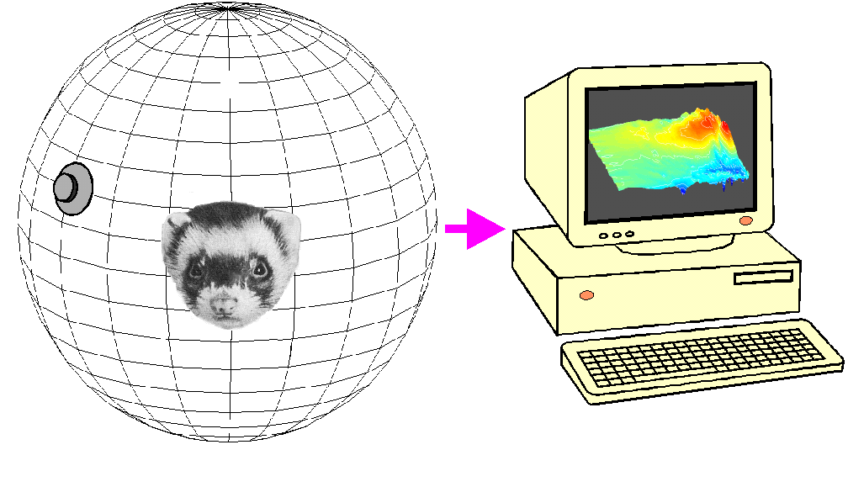
Creating Virtual Acoustic Space (VAS)
Probe Microphones

Slide 36
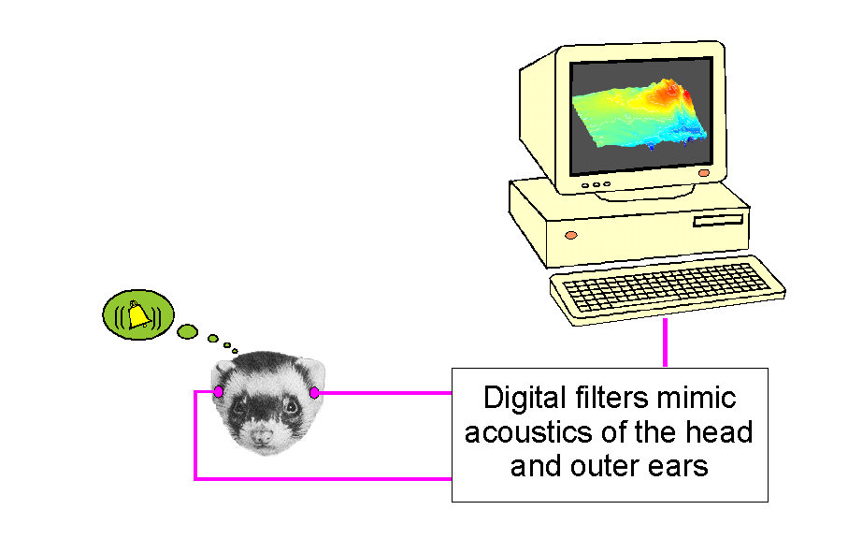
VAS response fields of A1 neurons
90
0
-90
-180 -90 0 90 180
0019/vas4@30
Microelectrode Recordings

Slide 37
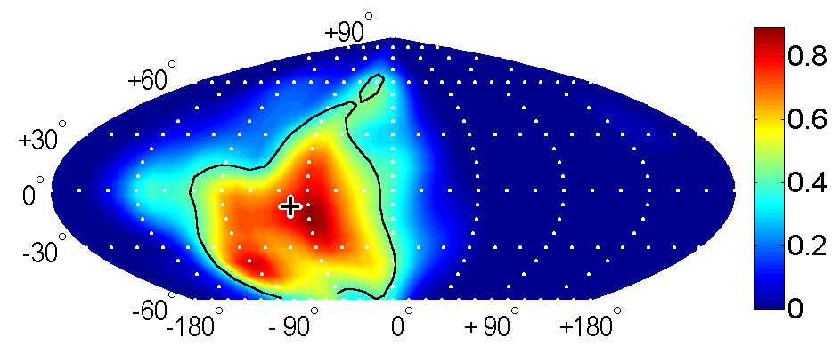
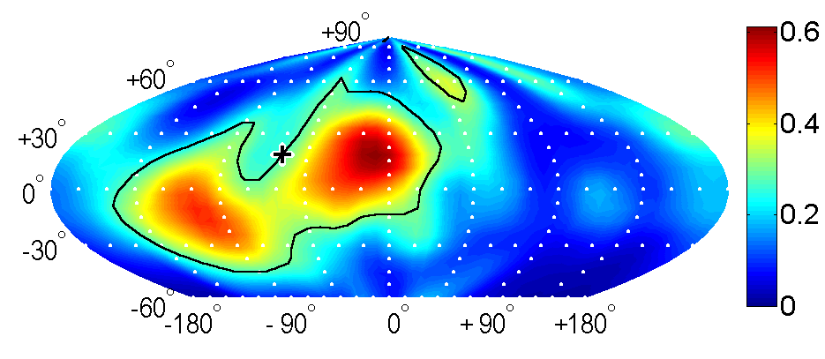
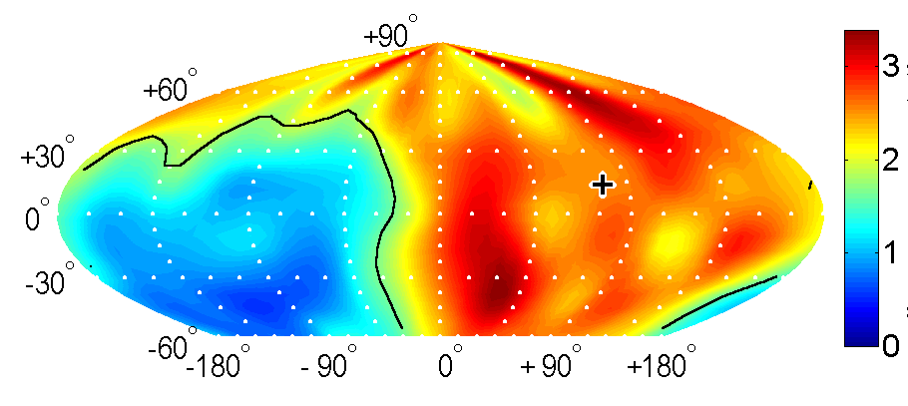
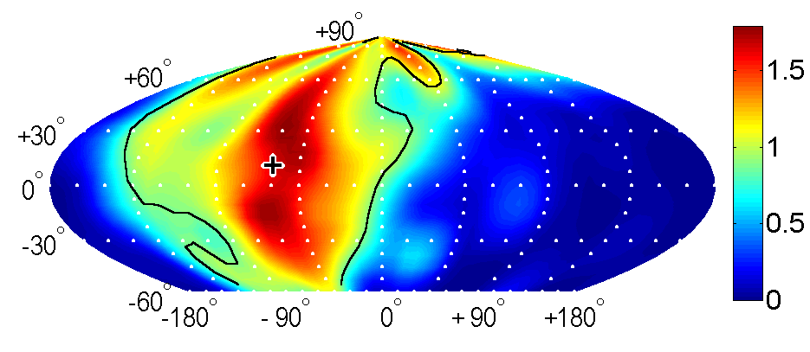
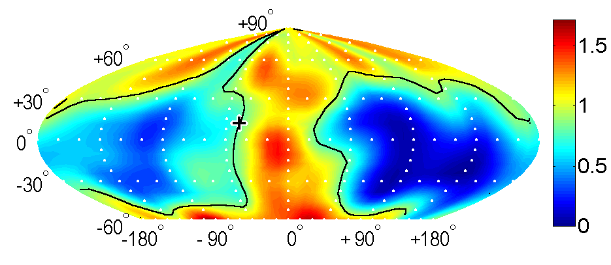
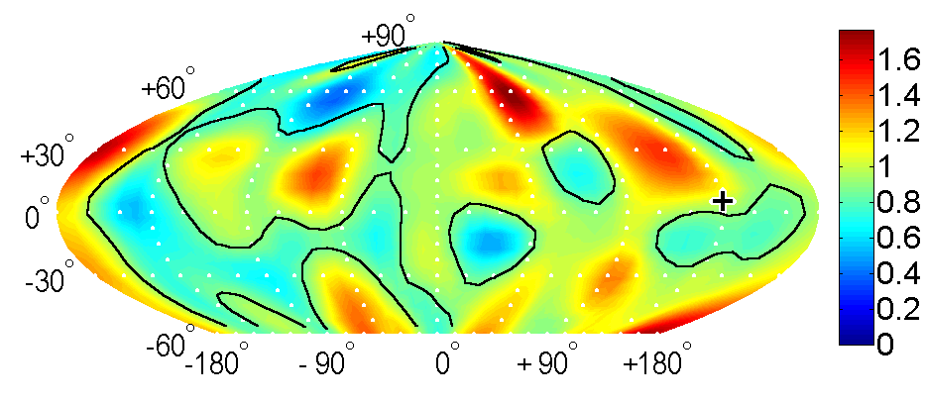
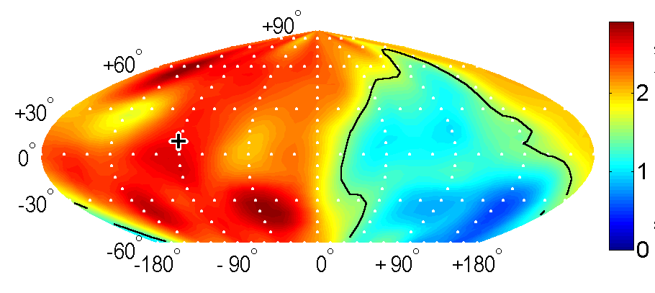
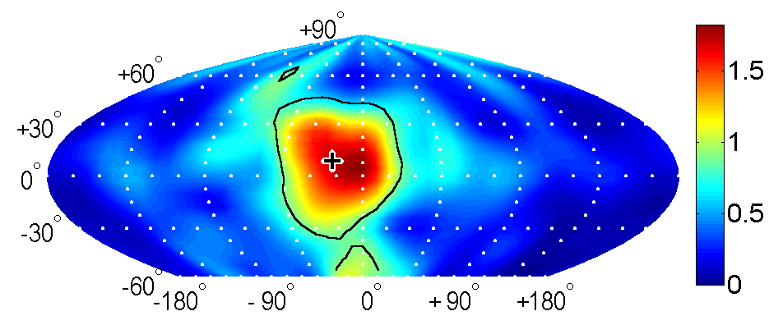
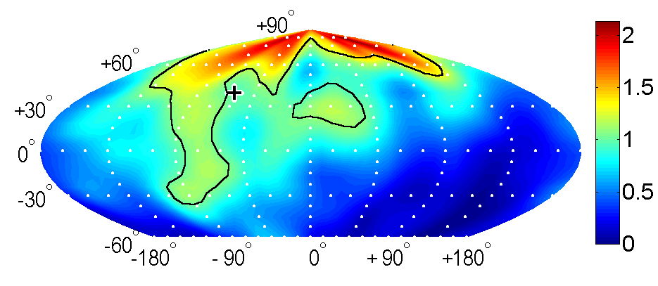
A1 Virtual Acoustic Space (VAS) Receptive Fields
A
B
C
#19-255, EO, CF=12, A=2.19, D=0.80, L=0.50, 15 dB
#54-94, EE, CF=9, A=2.77, D=2.29, L=0.19, 25 dB
#51-02, EE, CF=5, A=7.92, D=2.39, L=0.14, 15 dB
D
E
F
Spikes per presentation
#51-19, EO, CF=17, A=4.36, D=1.49, L=0.37, 20 dB
#38-78, EO, CF=7, A=5.06, D=2.59 L=0.10, 35 dB
#51-07, OE, CF=5, A=8.23, D=2.84, L=0.03, 35 dB
G
H
I
#54-12, EI, CF=8, A=8.28, D=2.39, L=0.13, 20 dB
#54-304, EE, CF=28, A=1.37, D=1.77, L=0.29, 15 dB
#51-15, EE, CF=21, A=1.97, D=3.03, L=0.21, 20 dB

Slide 38



Predicting Space from
Spectrum
a
Left and Right Ear Frequency-Time Response Fields
Virtual Acoustic Space Stimuli
d
Frequency [kHz]
Elev [deg]
b
e
c
f
Schnupp et al Nature 2001

Slide 39






Examples of Predicted and Observed Spatial Receptive Fields

Slide 40

“Higher Order” Cortical Areas
In the macaque, primary auditory cortex(A1) is surrounded by rostral (R), lateral (L), caudo-medial (CM) and medial “belt areas”.
L can be further subdivided into anterior, medial and caudal subfields (AL, ML, CL)

Slide 41

Are there “What” and “Where” Streams in Auditory Cortex?
Anterolateral
Belt
Some reports suggest that anterior cortical belt areas may more selective for sound identity and less for sound source location, while caudal belt areas are more location specific.
It has been hypothesized that these may be the starting positions for a ventral “what” stream heading for inferotemporal cortex and a dorsal “where” stream which heads for postero-parietal cortex.
Caudolateral
Belt

Slide 42


A “Panoramic” Code for Auditory Space?
Middlebrooks et al.
found neural spike
patterns to vary systematically with sound source direction in a number cortical areas of the cat (AES, A1, A2, PAF).
Artificial neural networks can be trained to estimate sound source azimuth from the neural spike pattern.
Spike trains in PAF carry more spatial information than other areas, but in principle spatial information is available in all auditory cortical areas tested so far.

Slide 43


Responses to Artificial Vowels in Space
Vowel type (timbre)
Pitch (Hz)
Bizley et al J Neurosci 2009 29:2064

Slide 44

Azimuth, Pitch and Timbre Sensitivity in Ferret Auditory Cortex
Bizley et al J Neurosci 2009 29:2064

Slide 45

Cortical Deactivation
Deactivating some cortical areas (A1, PAF) by cooling impairs sound localization, but impairing others (AAF) does not.
Lomber & Malhorta J. Neurophys (2003)

Slide 46
Further Reading
Schnupp J, Nelken I, King A (2011) Auditory Neuroscience: Making Sense of Sound – Chapter 5
King AJ, Schnupp JW, Doubell TP (2001) The shape of ears to come: dynamic coding of auditory space. Trends in Cognitive Sciences 5:261-270
Schnupp JW, Carr CE (2009) On hearing with more than one ear: lessons from evolution. Nature Neuroscience 12:692-697
Grothe B, Pecka M, McAlpine D (2010) Mechanisms of sound localization in mammals. Physiol Rev 90:983-1012

